Slide 1
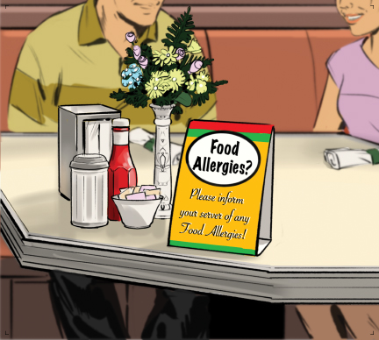
3
Contamination, Food Allergens, and Foodborne Illness

Slide 2
Learning Objectives
After completing this chapter, you should be able to:
Identify ways to prevent physical and chemical contamination.
Summarize how deliberate contamination of food can be prevented.
Identify the most common food allergens and their associated symptoms.
Describe methods of preventing allergic reactions.
Notes:
Instructor Notes
Please review the Coursebook Instructor Change Document for important information on 2022 FDA Food Code changes related to this chapter, as well as updates to food allergens content. More information can be found at www.ServSafe.com/Academic

Slide 3
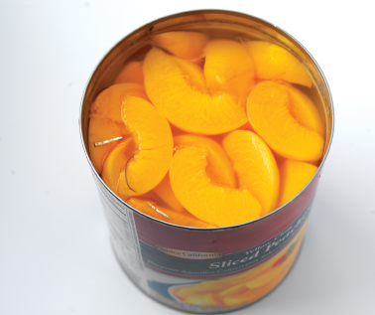
3.1 Physical Contaminants
Sources:
  Common objects that get into food like metal shavings from cans or fingernails
  Naturally occurring objects such as fruit pits and bones
Notes:
Instructor Notes
*This slide contains Core Food Safety content.

Slide 4
Physical Contaminants
Symptoms:
  Bleeding and pain
  Mild to fatal injuries are possible
Prevention:
  Purchase food from approved, reputable suppliers.
  Closely inspect food received.
  Practice good personal hygiene.
Notes:
Instructor Notes
*This slide contains Core Food Safety content.

Slide 5
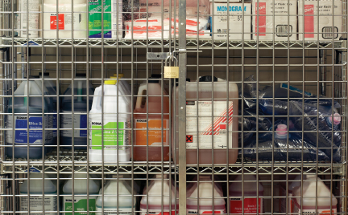

Chemical Contaminants
Sources:
  Cleaners, sanitizers, polishes, machine lubricants, and pesticides
  Deodorizers, first-aid products, and
  health and beauty products
  Certain types of kitchenware and equipment
Notes:
Instructor Notes
*This slide contains Core Food Safety content.
Holding acidic food in items made from pewter, copper, zinc, and some types of painted pottery increases risk of contamination

Slide 6
Chemical Contaminants Continued
Symptoms:
  Vary depending on chemical consumed
  Most illnesses occur within minutes
  Vomiting and diarrhea
Prevention includes:
  Use chemicals approved for use in foodservice operations.
  Purchase chemicals from approved, reputable suppliers.
  Store chemicals away from prep areas, food-storage areas, and service areas.
Notes:
Instructor Notes
*This slide contains Core Food Safety content.
NEVER store chemicals above food or food-contact surfaces.
Knowledge Check
Name an example of a physical contaminant.
How can chemical contamination be prevented?

Slide 7
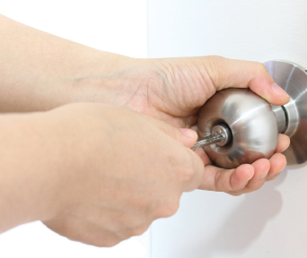
3.2 Deliberate Contamination of Food
A food defense program protects food by making it as difficult as possible for someone to tamper with it.
FDA’s A.L.E.R.T. food defense tool
Notes:
Instructor Notes
*This slide contains Core Food Safety content.
Knowledge Check
What is a food defense program?
A manager is limiting access to storage and prep areas. Which step of ALERT is the manager performing?

Slide 8
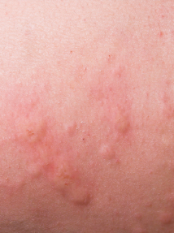
3.3 Food Allergens
A food allergen is a protein in a food to which some people are sensitive.
An allergic reaction is when the immune system mistakenly considers the allergen to be harmful and attacks the food protein.
Symptoms include:
  Nausea
  Wheezing or shortness of breath
  Hives or itchy rashes
Notes:
Instructor Notes
*This slide contains Core Food Safety content.
Initially symptoms of an allergic reaction may be mild, but they can become serious quickly. If a customer is having an allergic reaction to food, call the emergency number in your area.

Slide 9
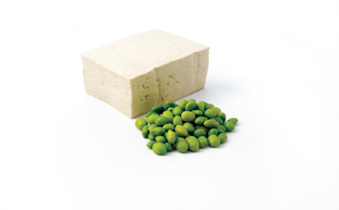
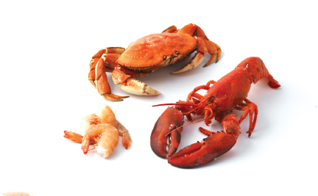
Common Food Allergens: The Big Nine
  Milk
  Soy
  Eggs
  Wheat
  Fish (ex: bass, flounder, and cod)
  Crustacean shellfish
  Peanuts
  Tree nuts (ex: walnuts and pecans)
  Sesame
Notes:
Instructor Notes
*This slide contains Core Food Safety content.
Activity: Allergens à la Carte

Slide 10

Preventing Allergic Reactions: Service
Service Staff
Describe menu and preparation to guests.
Clearly identify the guest’s order for
kitchen and service staff.
Deliver food separately to prevent
cross-contact.
Notes:
Instructor Notes
*This slide contains Core Food Safety content.

Slide 11
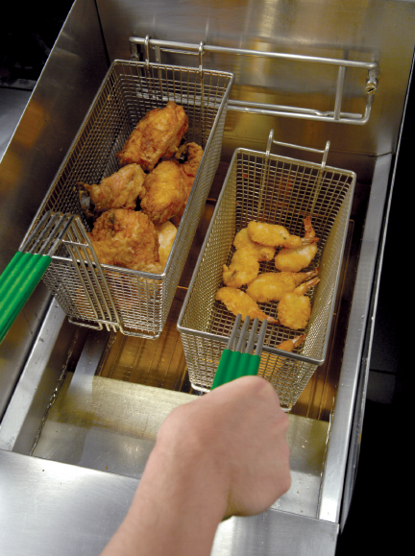
Preventing Allergic Reactions: Kitchen
Kitchen Staff
Avoid cross-contact.
Check food labels for allergens.
Notes:
Instructor Notes
*This slide contains Core Food Safety content.
Staff must make sure that allergens are not transferred from food or food-contact surfaces containing an allergen to the food served to the customer. This is called cross-contact.

Slide 12
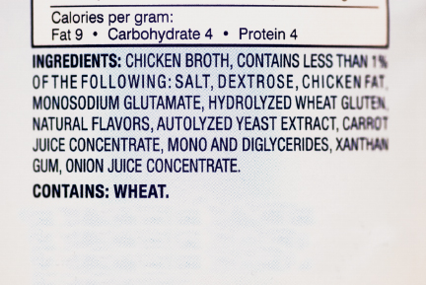
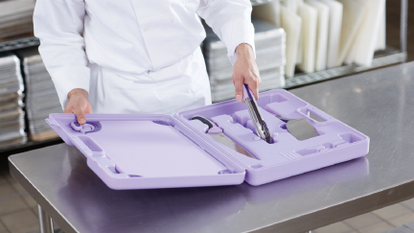
Preventing Allergic Reactions
Ways to avoid cross-contact include:
  Check recipes and ingredient labels.
  Wash, rinse, and sanitize cookware, utensils, and equipment.
  Wash hands and change gloves before prepping food.
Notes:
Instructor Notes
*This slide contains Core Food Safety content.
Knowledge Check
What are the Big Nine allergens?
Name three ways cross-contact can be avoided.

Slide 13
Discussion Questions
What are some ways to keep food safe from physical contaminants?
A prep cook has decided to wear earrings while working. What is the food safety risk?
What are some ways to keep chemicals from contaminating food?
What are some ways to prevent the deliberate contamination of food?
What measures can be taken to help ensure the safety of guests with food allergies?
Notes:
Answers
1. What are some ways to keep food safe from physical contaminants?
There are several ways to keep food safe from physical contaminants
Purchase food from approved, reputable suppliers.
Closely inspect the food you receive.
Take steps to make sure no physical contaminants can get into food in your operation. This includes making sure that food handlers practice good personal hygiene.
2. A prep cook has decided to wear earrings while working. What is the food safety risk?
The earrings could fall into food and contaminate it. If a person were to bite down or eat the earrings, they could receive a cut or dental damage, or even choke.
3. What are some ways to keep chemicals from contaminating food?
There are several ways to keep chemicals from contaminating food:
Make sure chemicals are approved for use in a foodservice operation.
Purchase chemicals from approved, reputable suppliers.
Store chemicals away from prep areas, food-storage areas, and service areas.
Separate chemicals from food and food-contact surfaces by spacing and partitioning.
Do not store chemicals above food or food-contact surfaces.
Use chemicals for their intended use and follow manufacturers’ directions.
Only handle food with equipment and utensils approved for foodservice use.
Make sure the manufacturers’ labels on original chemical containers are readable.
Follow the manufacturers’ directions and local regulatory requirements when throwing out chemicals.
4. What are some ways to prevent the deliberate contamination of food?
There are several ways to prevent the deliberate contamination of food:
• Make sure that the products you receive are from safe sources.
• Monitor the security of products in the operation.
• Know who is in the operation.
• Keep information related to food defense accessible.
• Identify what you will do and who you will contact if there is suspicious activity or a threat at your operation.
5. What measures can be taken to help ensure the safety of guests with food allergies?
There are several measures that can be taken by both service staff and kitchen staff to ensure the safety of guests with food allergies.
Service staff:
Describe dishes so guests know how they are prepared.
Tell guests if the food they are allergic to is in the menu item.
Identify any secret ingredients.
Suggest menu items that do not contain the food that the guest is allergic to.
Clearly mark the order for the guest with the identified food allergy.
Deliver food to the guest with the allergy separately from other food delivered to the table.
Kitchen staff:
Check recipes and ingredient labels to confirm that the allergen is not present.
Wash, rinse, and sanitize cookware, utensils, and equipment before prepping food. If possible, use a separate set of cooking utensils just for allergen special orders.
Make sure the allergen does not touch anything for guests with food allergies, including food, beverages, utensils, equipment, and gloves.
Wash your hands and change gloves before prepping food.
Use separate fryers and cooking oils when frying food for guests with food allergies.
Label food packaged on-site.

