Slide 1
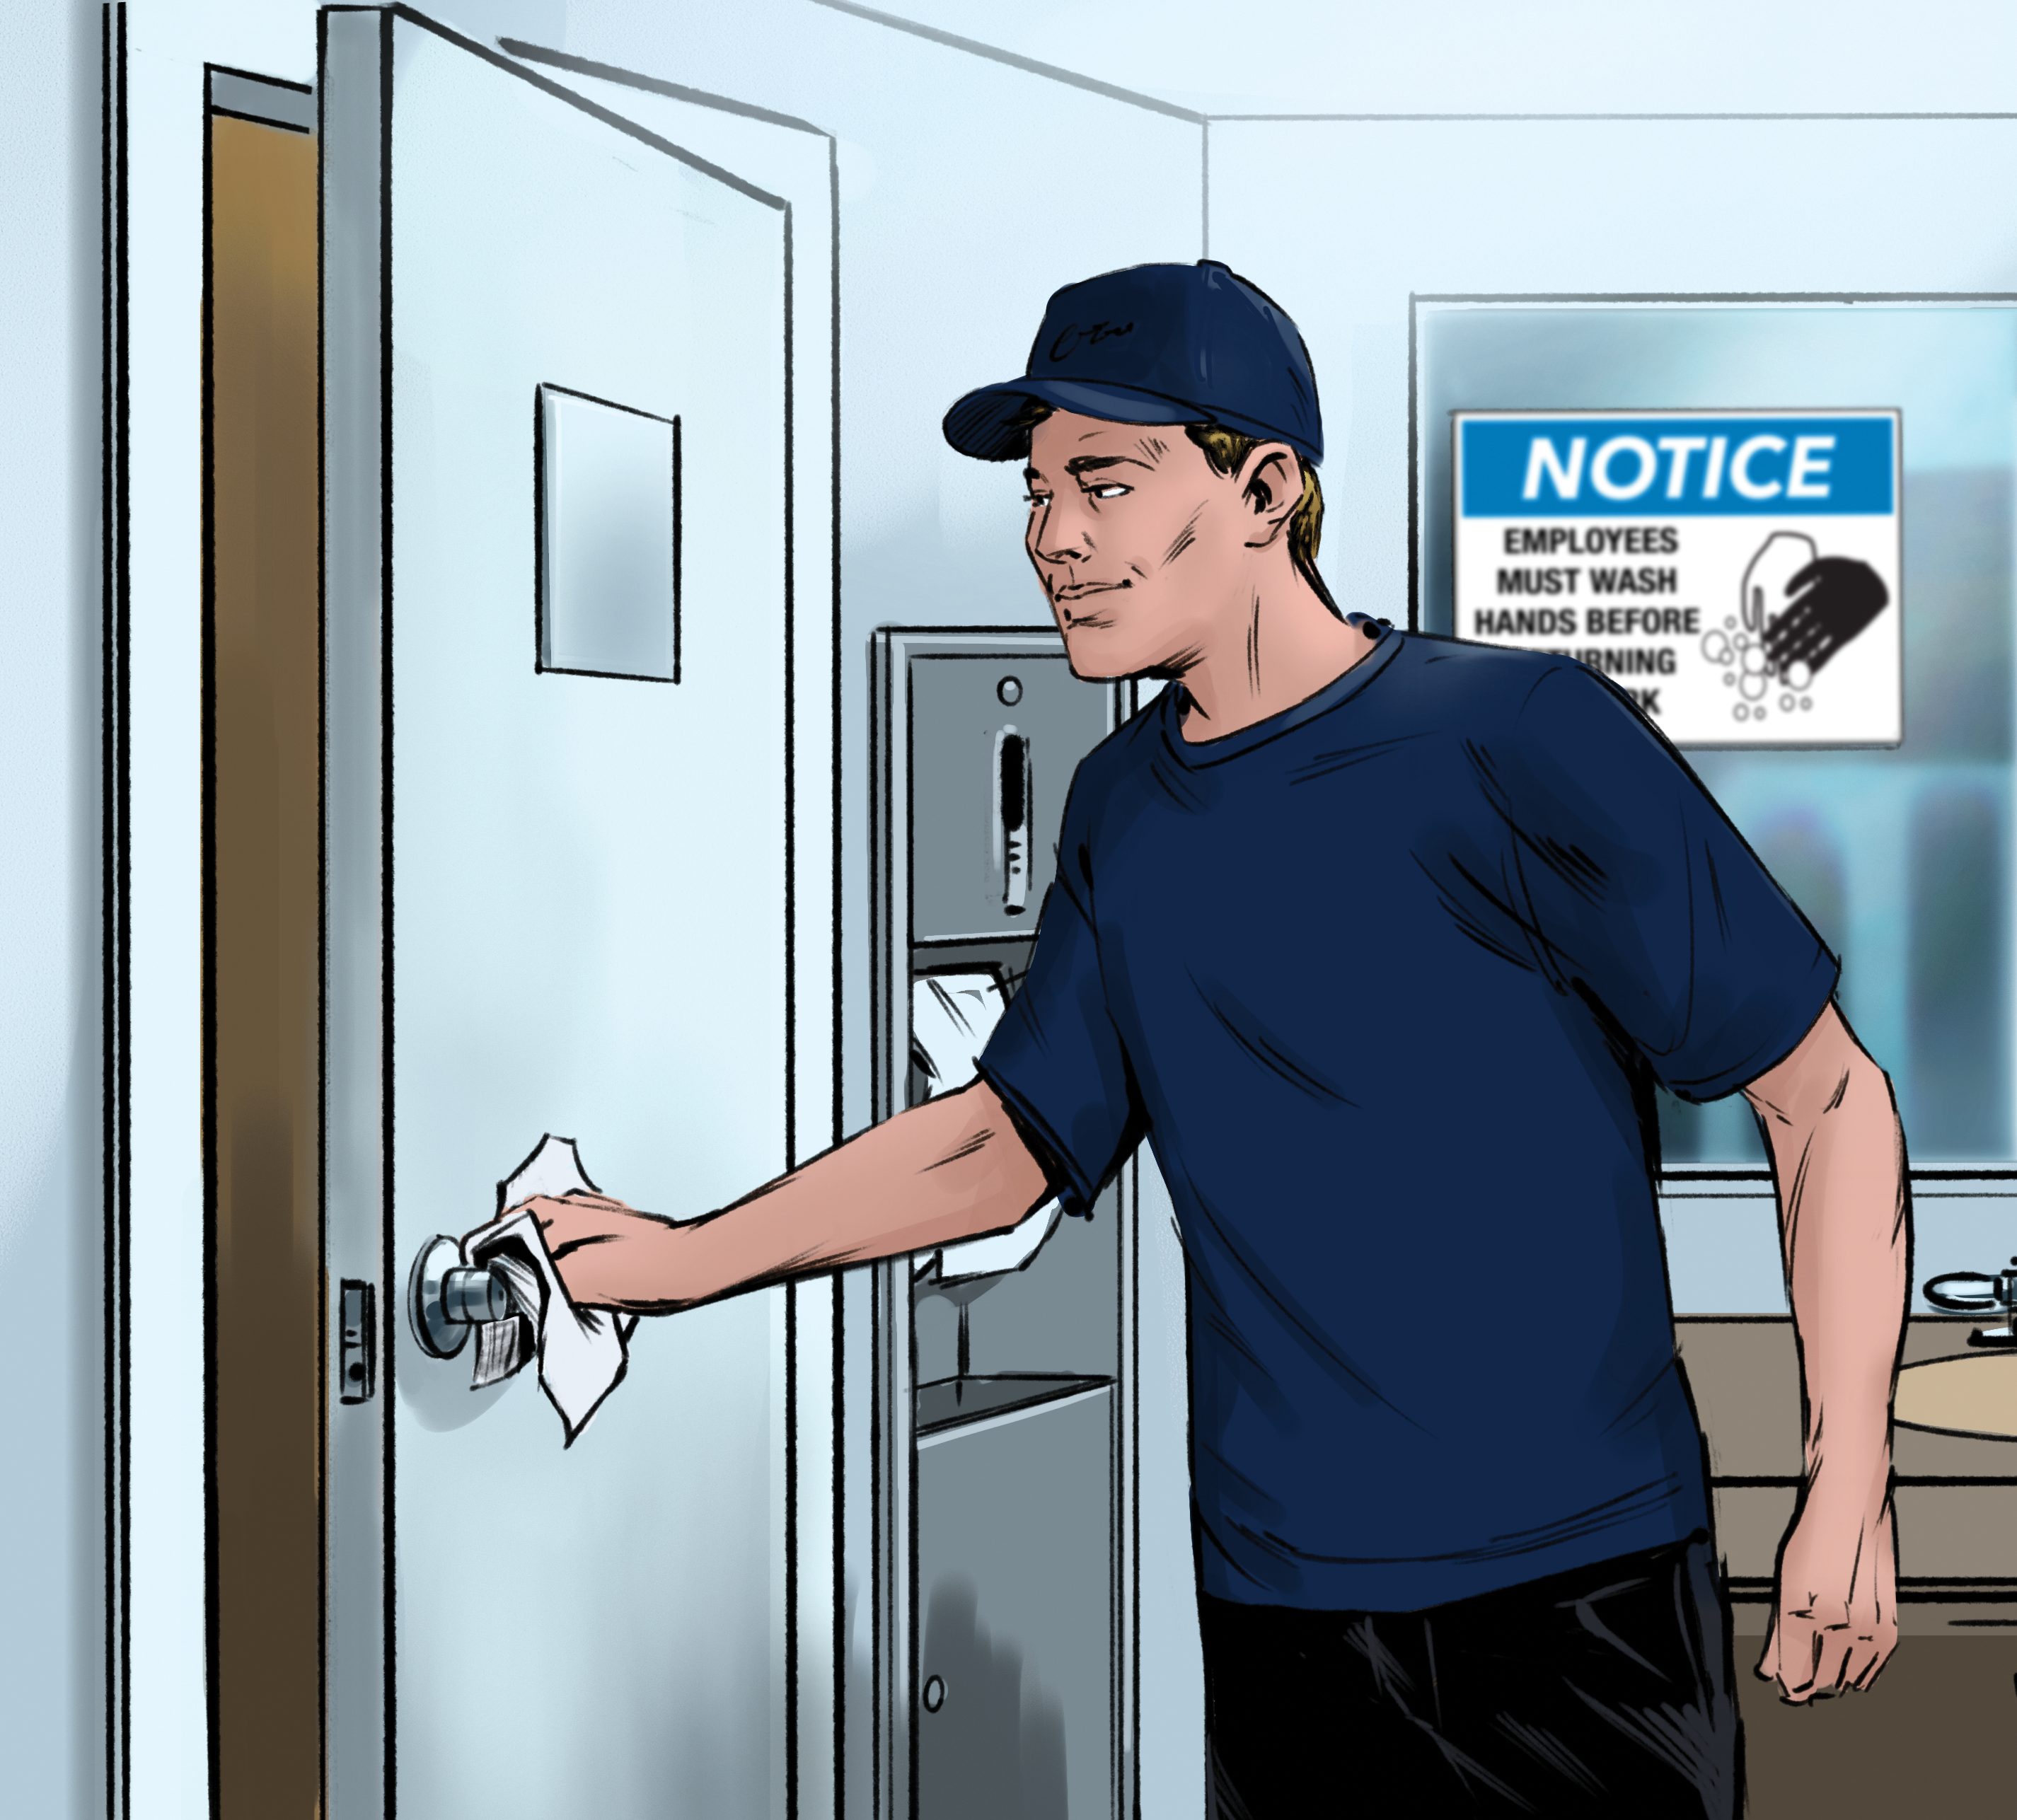
4
The Safe Food Handler

Slide 2
Learning Objectives
After completing this chapter, students should be able to:
Describe the requirements for personal hygiene and cleanliness.
Describe how food handlers contaminate food and how to prevent contamination.
Identify proper handwashing techniques and procedures and hand care requirements.
Explain the importance of avoiding bare hand contact with ready-to-eat food.
Identify criteria for excluding staff from the operation or restricting them from working with or around food.
Notes:
Instructor Notes
Please review the Coursebook Instructor Change Document for important information on 2022 FDA Food Code changes related to this chapter. More information can be found at www.ServSafe.com/Academic

Slide 3
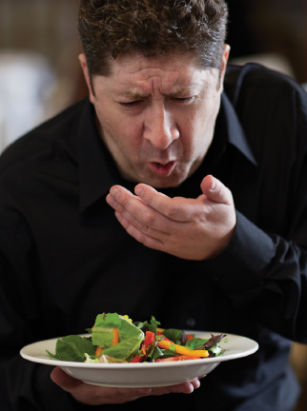
4.1 How Food Handlers Contaminate Food
Food handlers can contaminate food when:
They have symptoms of a foodborne illness.
They have wounds or boils that contain a pathogen.
They have contact with a person who is ill.
They use the restroom and do not wash their hands.
Notes:
Instructor Notes
*Section 4.1 contains Core Food Safety content.

Slide 4
Diseases Not Transmitted through Food
Diseases such as HIV/AIDS, Hepatitis B and C, and tuberculosis are not spread through food.
  Americans with Disabilities Act (ADA) provides employees with civil-rights protections.
    Employees cannot be fired or transferred because of their disease.
    Employers must maintain the confidentiality of any staff member who has an illness that is not foodborne.
Notes:
Knowledge Check
List at least five situations in which food handlers contaminate food.
As it relates to food safety, what is a carrier?

Slide 5
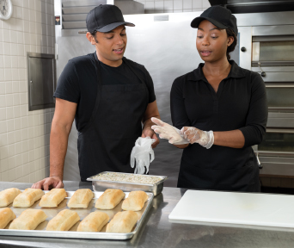
4.2 A Good Personal Hygiene Program
  An operation’s personal hygiene program should include:
  Creating personal hygiene policies
  Training and retraining food handlers on policies
  Modeling correct behavior at all times
  Revising policies when laws or science change
Notes:
Instructor Notes
*This slide contains Core Food Safety content.

Slide 6
Handwashing
How to properly wash hands:
Wet hands and arms.
Apply soap.
Scrub hands and arms vigorously for 10-15 seconds.
Rinse hands and arms thoroughly.
Dry hands and arms.
The whole process should take at least 20 seconds.
Wash hands only in a sink designated for handwashing.
Only use hand antiseptics after handwashing. NEVER use them in place of it.
Notes:
Instructor Notes
*This slide contains Core Food Safety content.

Slide 7
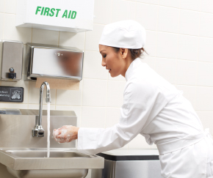
When to Wash Hands
Food handlers must wash their hands before:
  Preparing food
  Working with clean equipment and utensils
  Putting on single-use gloves
Notes:
Instructor Notes
*This slide contains Core Food Safety content.

Slide 8

When to Wash Hands
Activities after which a food handler must wash their hands include:
  Using the restroom
  Touching the body or clothing
  Eating, drinking, or smoking
  Handling soiled items
  Handling raw meat, seafood, or poultry
  Changing tasks
  Using electronic devices
Notes:
Instructor Notes
*This slide contains Core Food Safety content.

Slide 9
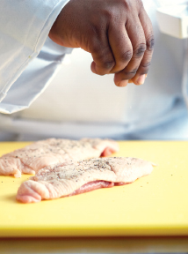
Bare-Hand Contact with Ready-to-Eat Food
Avoid bare-hand contact with ready-to-eat food unless it
is in a dish that does not contain raw meat, seafood, or poultry and the dish will be cooked to at least 145˚F (63˚C).
is in a dish containing raw meat, seafood, or poultry and the dish will be cooked to the required minimum internal temperature of the raw item.
Notes:
Instructor Notes
*This slide contains Core Food Safety content.
If you primarily serve a high-risk population, NEVER handle ready-to-eat food with bare hands.

Slide 10
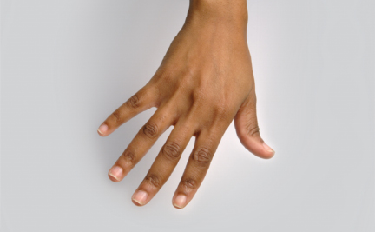
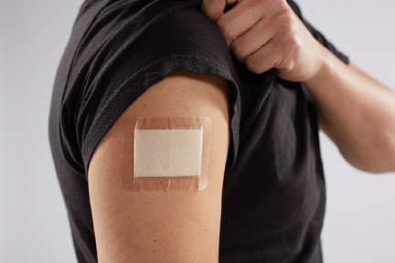
Hand Care
Fingernails
Keep fingernails short and clean.
Avoid nail polish and false fingernails.
Infected wounds or boils
Cover to prevent pathogens from contaminating food and food-contact surfaces.
How an infected wound or boil is covered depends on where it is located.
Notes:
Instructor Notes
*This slide contains Core Food Safety content.
Nail polish and false fingernails can be worn if the food handler wears single-use gloves.

Slide 11
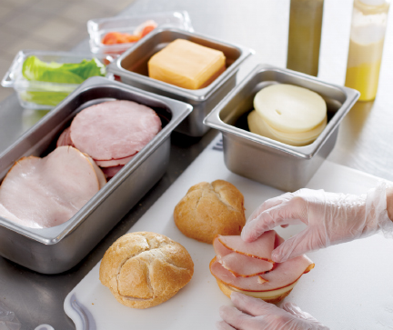
Single-Use Gloves
Never use in place of handwashing.
Use when handling ready-to-eat food.
Use only gloves approved for foodservice.
Supply different types, multiple sizes, and latex alternatives.
Notes:
Instructor Notes
*This slide contains Core Food Safety content.

Slide 12
Using Single-Use Gloves
Guidelines for using single-use gloves include:
  Wash hands before putting on gloves.
  Select the correct size.
  Hold gloves by the edge when putting them on.
  Situations when a food handler should change gloves include:
  Before beginning a new task
  Between handling raw meat, seafood, or poultry and ready-to-eat food
  After four hours of continuous use
Notes:
Instructor Notes
*This slide contains Core Food Safety content.

Slide 13
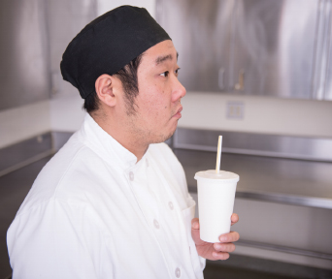
Other Good Personal Hygiene Practices
Develop staff policies for
Personal cleanliness
Correct work attire
Eating, drinking, smoking, and chewing gum or tobacco
Notes:
Instructor Notes
*This slide contains Core Food Safety content.

Slide 14

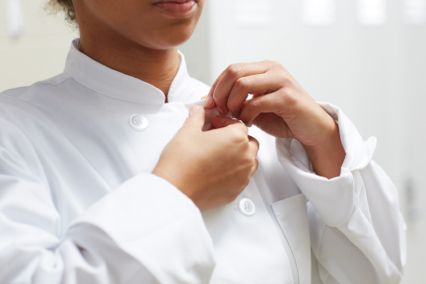
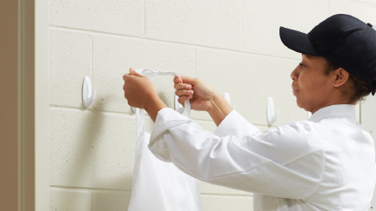

Work Attire Guidelines
Notes:
Instructor Notes
*This slide contains Core Food Safety content.
Pictures (from top left) 1. Hair restraints 2. Clean clothing 3. Aprons 4. Jewelry
Activity: Food Safety Anti-Vision Board

Slide 15
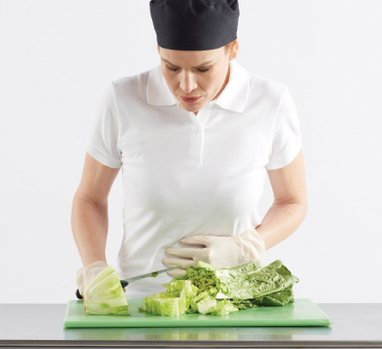
Reporting Health Issues
Staff must tell you if they are sick
Before they come to work
If they get sick while working
If they or someone they live with has been diagnosed with an illness from a “Big Six” pathogen.
Notes:
Instructor Notes
*This slide contains Core Food Safety content.

Slide 16
Watching for Staff Illness
Monitor staff for signs of illness including:
Vomiting
Excessive trips to the bathroom
Jaundice
Persistent nasal discharge and sneezing
Work with your regulatory authority to determine which symptoms require an employee to be restricted or excluded from the operation.
Notes:
Instructor Notes
*This slide contains Core Food Safety content.
Knowledge Check
What are the steps for proper handwashing?
A prep cook at a restaurant located in a shopping mall has a sore throat with a fever. What action must the manager take?

Slide 17
Discussion Questions
What are some basic work attire requirements for staff?
What personal behaviors can contaminate food?
What are some basic guidelines for hand care?
What procedures must food handlers follow when using gloves?
What staff health problems pose a possible threat to food safety? What are the appropriate actions that should be taken?
When handling produce, when must single-use gloves be worn?
Notes:
Answers
1. What are some basic work-attire requirements for staff?
Staff must meet the following work attire requirements:
Wear a clean hat or other hair restraint.
Wear clean clothing daily.
Remove aprons when leaving food-preparation areas.
Remove jewelry from hands and arms before preparing food or when working around prep areas.
2. What personal behaviors can contaminate food?
The following personal behaviors can contaminate food:
Wiping or touching the nose
Rubbing an ear
Scratching the scalp
Touching a pimple or an infected wound
Running fingers through the hair
3. What are some basic guidelines for hand care?
The following are some basic guidelines for hand care:
Keep fingernails short, clean, and filed.
Do not wear false fingernails.
Do not wear nail polish.
4. What procedures must food handlers follow when using gloves?
Food handlers must follow these procedures when wearing gloves to handle food:
Wash hands before putting on gloves when starting a new task.
Choose the correct glove size.
Hold gloves by the edge when putting them on. Avoid touching the glove as much as possible.
Check gloves for rips and tears after they have been put on.
Never blow into gloves.
Never roll gloves to make them easier to put on.
Never wash and reuse gloves.
5. What staff health problems pose a possible threat to food safety? What are the appropriate actions that should be taken?
These staff health problems pose a possible threat to food safety:
Infected wound or boil that is not properly covered. Restrict the food handler from working with exposed food, utensils, and equipment.
Sore throat with fever. Restrict the food handler from working with exposed food, utensils, and equipment. Exclude the food handler from the operation if you primarily serve a high-risk population.
Persistent sneezing, coughing, or a runny nose that causes discharge from the eyes, nose, or mouth. Restrict the food handler from working with exposed food, utensils, and equipment.
Vomiting, diarrhea, or jaundice from an infectious condition. Exclude the food handler from the operation. Food handlers who vomit or have diarrhea cannot return to work unless they have had no symptoms for at least 24 hours or have a written release from a medical practitioner. Food handlers with jaundice must be reported to the regulatory authority. Food handlers who have had jaundice for seven days or less must be excluded from the operation. They cannot return to work unless they have a written release from a medical practitioner and approval from the regulatory authority.
A foodborne illness caused by one of these pathogens and symptoms of diarrhea or vomiting: Norovirus; Shigella spp.; nontyphoidal Salmonella; or Shiga toxin-producing E. coli. Exclude the food handler from the operation. Report the situation to the regulatory authority. Work with the medical practitioner and the local regulatory authority to determine when the employee can safely return to the operation and/or carry out regular food-handling duties.
A foodborne illness caused by one of these pathogens: Hepatitis A or Salmonella Typhi. Exclude the food handler from the operation. Report the situation to the regulatory authority. Some food handlers diagnosed with an illness may not experience symptoms, or their symptoms may have ended. Work with the medical practitioner and the local regulatory authority to determine whether the food handlers must be excluded from the operation or restricted from working with exposed food, utensils, and equipment. The medical practitioner and regulatory authority will also determine when the employees can safely return to the operation and/or carry out their regular food-handling duties.
6. When handling produce, when must single-use gloves be worn?
Single-use gloves should always be worn whenever handling produce that is ready-to-eat without any further washing or cooking. Single-use gloves are not required when washing produce. They also do not need to be worn when handling ready to eat ingredients that will be cooked to the correct internal temperature. An example of this would be adding onions to a beef roast which will then be fully cooked.

