Slide 1
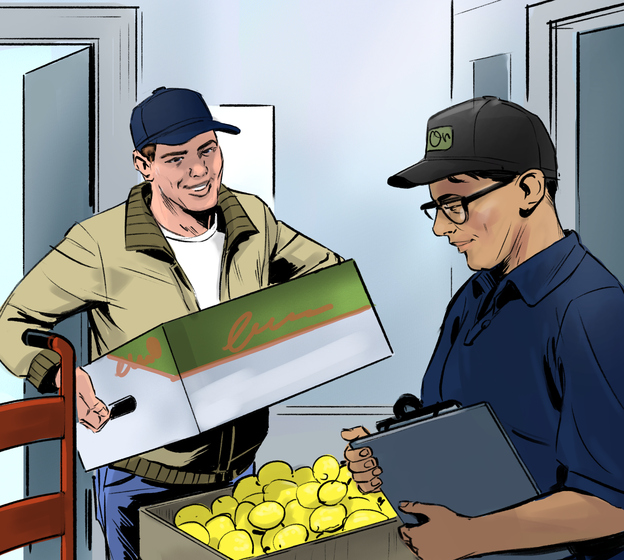
6
The Flow of Food: Purchasing and Receiving

Slide 2
Learning Objectives
Identify the requirements for receiving food and nonfood items.
Explain procedures for unacceptable merchandise and product recalls.
Describe criteria for an approved supplier.
Identify government inspection stamps and documentation required when receiving food.
Notes:
Instructor Notes
Please review the Coursebook Instructor Change Document for important information on 2022 FDA Food Code changes related to this chapter. More information can be found at www.ServSafe.com/Academic

Slide 3

6.1 Purchasing Considerations
Purchase food from approved, reputable suppliers.
  They have been inspected and can show reports.
  They meet all applicable local, state, and federal laws
Notes:
Instructor Notes
*This slide contains Core Food Safety content.
Knowledge Check
What is one way you can avoid food safety hazards when purchasing food?
What are some items that should be reviewed on a supplier inspection report?

Slide 4
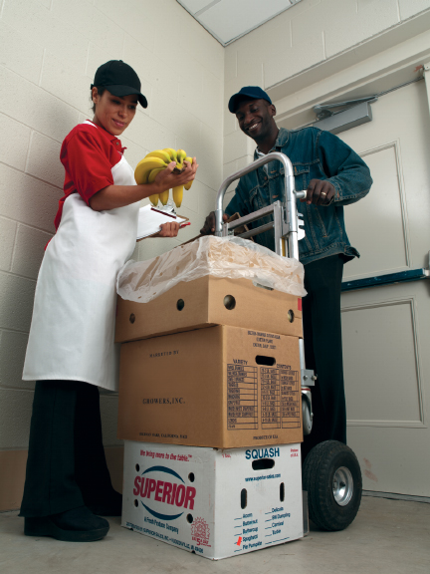
6.2 Receiving Considerations
  Receiving guidelines:
  Have food delivered when staff can inspect it.
  Make specific staff responsible for receiving.
  Plan for shipments in advance.
  Inspect deliveries immediately.
Notes:
Instructor Notes
*This slide contains Core Food Safety content.

Slide 5
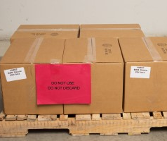
Inspecting Deliveries
Rejection & Recalls
You can refuse any delivery that does not meet your standards.
Staff should know how to reject an item or a shipment.
Food items are sometimes recalled by the manufacturer.
Notes:
Instructor Notes
*This slide contains Core Food Safety content.
Knowledge Check
Name three practices that can keep food deliveries safe.
How should an item that has been recalled be handled?

Slide 6
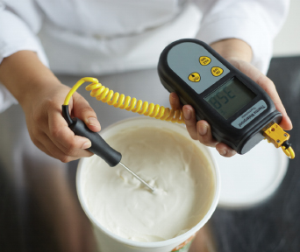
6.3 General Inspection Guidelines
Temperatures
Employees who receive food deliveries should know
what temperature different foods should be received at.
how to check using a thermometer.
Notes:
Instructor Notes
*This slide contains Core Food Safety content.

Slide 7
General Inspection Guidelines Continued
Inspect packaging for:
Damage
Liquid
Signs of pests
Dates
Documents and Stamps
Shellstock identification tags
indicate when and where the shellfish were harvested.
Inspection and grading stamps
Meat, poultry, and eggs
Notes:
Instructor Notes
*This slide contains Core Food Safety content.

Slide 8
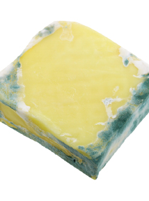
General Inspection Guidelines: Quality
Food Quality
  Appearance: Reject food that is moldy or has an abnormal color.
  Texture: Reject meat, fish, or poultry if
    it is slimy, sticky, or dry.
    it has soft flesh that leaves an imprint when touched.
  Odor: Reject food with an abnormal or unpleasant odor.
Notes:
Instructor Notes
*This slide contains Core Food Safety content.
Knowledge Check
Name three reasons why you might reject a can from a supplier.
What information is included on a shellstock identification tag?

Slide 9
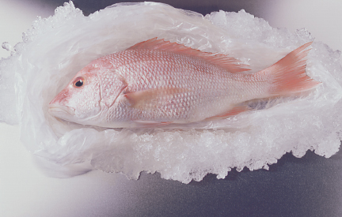
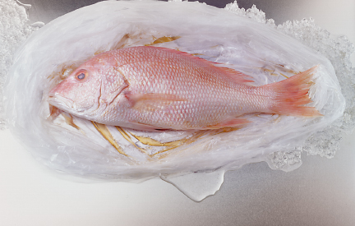
6.4 Inspecting Specific Types of Food
Fresh Fish
Accept
Reject

Slide 10
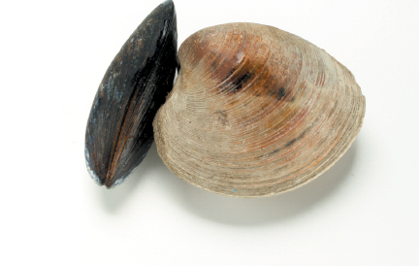
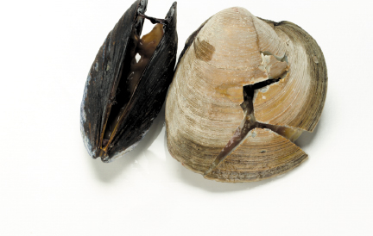
Inspecting Specific Types of Food
Shellfish
Accept
Reject

Slide 11
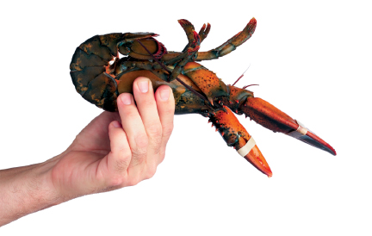
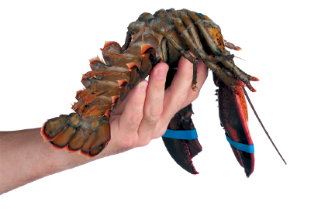
Inspecting Specific Types of Food: Crustaceans
Crustaceans
Accept
Reject

Slide 12
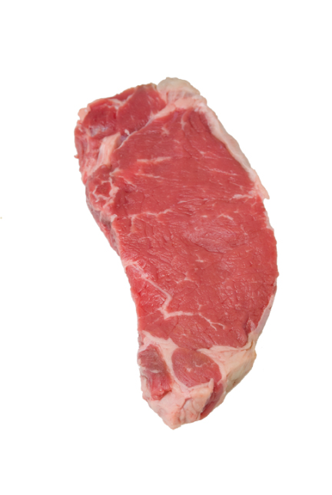
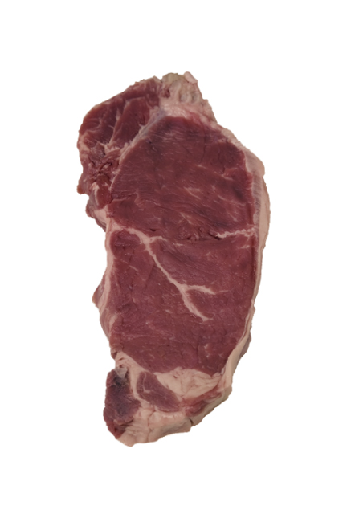
Inspecting Specific Types of Food: Meat
Meat
Accept
Reject

Slide 13
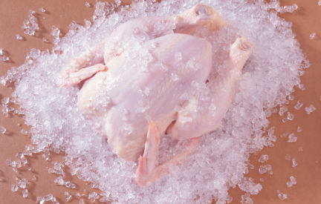
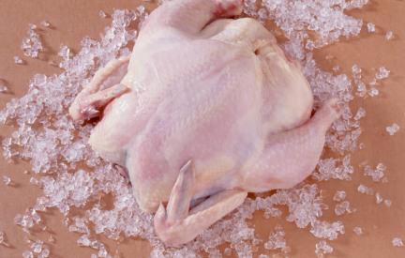
Inspecting Specific Types of Food: Poultry
Poultry
Accept
Reject

Slide 14
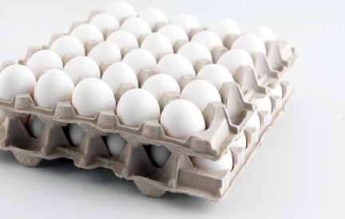
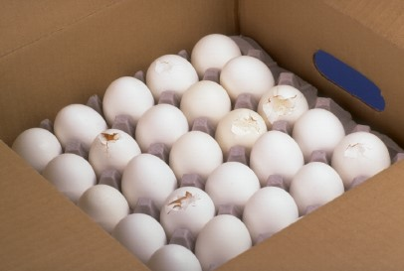
Inspecting Specific Types of Food: Eggs
Shell Eggs
Accept
Reject

Slide 15
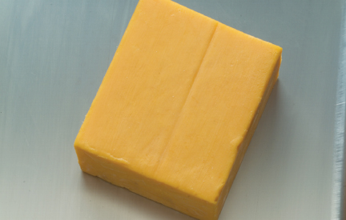
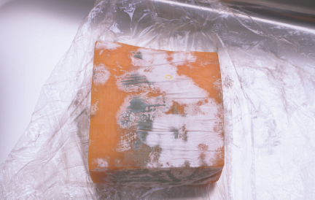
Inspecting Specific Types of Food: Dairy
Dairy Products
Accept
Reject

Slide 16
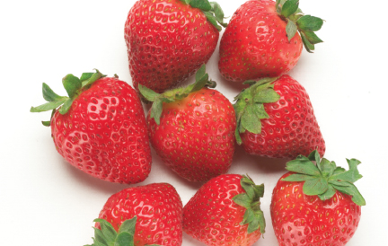
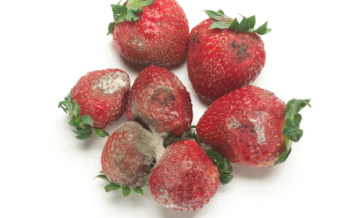
Inspecting Specific Types of Food: Produce
Fresh Produce
Accept
Reject
Notes:
Instructor Notes
Activity: Purchasing and Receiving Cheat Sheet
Knowledge Check
1. What are the criteria for accepting fresh fish?
2. Name criteria for rejecting poultry.

Slide 17
Discussion Questions
What are some general guidelines for receiving food safely?
What are some general guidelines for inspecting food?
What are the correct methods for checking the temperatures of fresh poultry delivered on ice and a carton of milk? What should the temperature be for each?
What are the criteria for rejecting a delivery of fresh strawberries?
Notes:
Answers
1. What are some general guidelines for receiving food safely?
Here are some general guidelines for receiving food safely:
Have suppliers deliver food when there is time to inspect it.
Make specific staff responsible for receiving. Train them to follow food safety procedures and provide them with the tools they need to receive and inspect deliveries.
Make sure there is enough trained staff to receive and inspect food promptly.
Plan ahead for deliveries. Make sure that equipment is clean and there is enough storage space to hold deliveries.
Inspect deliveries immediately upon receipt. Start by inspecting the overall condition of the delivery trucks. Then inspect the food. Count quantities, check for damage, and look for items that might have been repacked or mishandled. Spot-check weights. Take sample temperatures of all TCS food.
Inspect and store each delivery before accepting another one.
2. What are some general guidelines for inspecting food?
Here are some general guidelines for inspecting food:
Make sure TCS food is received at safe temperatures. Take sample temperatures of all TCS food. Receive cold TCS food at 41°F (5°C) or lower unless otherwise specified. Receive hot TCS food at 135°F (57°C) or higher.
Make sure packaging is intact and cleans and protects food and food-contact surfaces from contamination. Reject items with damaged packaging, including leaks, dampness, or water stains.
Make sure items have the correct documentation and stamps.
Make sure food quality is acceptable and meets your operation’s standards.
3. What are the correct methods for checking the temperatures of fresh poultry delivered on ice and a carton of milk? What should the temperature be for each?
Here is how to check the temperature of each product:
Fresh poultry: Insert the thermometer stem or probe into the thickest part of the poultry. The center is usually the thickest part. The temperature should be 41°F (5°C) or lower.
Carton of milk: Open the carton and insert the thermometer stem or probe into the milk. Fully immerse the sensing area. The stem or probe must not touch the carton. The temperature should be 45°F (7°C) or lower when receiving the milk. However, it must be cooled to 41°F (5°C) or lower in four hours.
When checking temperatures, it is a best practice to take another reading in a different spot. The temperature may vary in different areas.
4. What are the criteria for rejecting a delivery of fresh strawberries?
A shipment of fresh strawberries should be rejected for any of the following conditions:
evidence of mishandling
insects (including insect eggs and egg cases)
mold
cuts
wilting
unpleasant odors
discoloration

