Slide 1
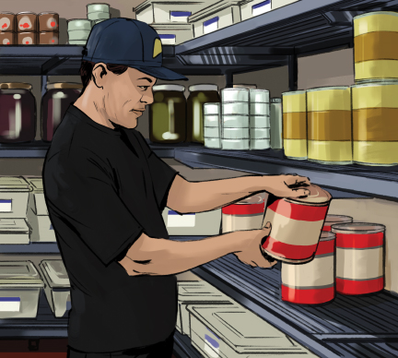
7
The Flow of Food: Storage

Slide 2
Learning Objectives
After completing this chapter, you should be able to:
Describe how to properly label and date mark food.
Explain time and temperature requirements for food in storage.
Describe how to prevent temperature abuse during storage.
Describe how to prevent cross-contamination during storage.
Explain how to rotate food using the first-in, first-out (FIFO) method.
Identify guidelines for storing specific types of food including meat, poultry, fish, shellfish, eggs, produce, and dry food.
Notes:
Instructor Notes
Please review the Coursebook Instructor Change Document for important information on 2022 FDA Food Code changes related to this chapter. More information can be found at www.ServSafe.com/Academic

Slide 3
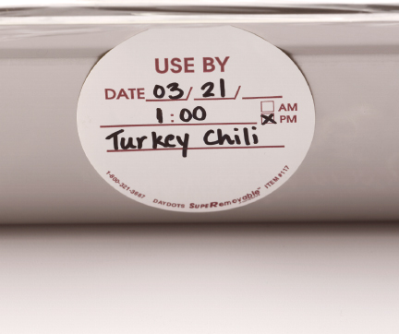
7.1 General Storage Guidelines
Labeling food
Onsite: label any item not being stored in its original container
Retail: label food that is packaged on site and sold for customers to use at home
Notes:
Instructor Notes
*This slide contains Core Food Safety content.

Slide 4
General Storage Guidelines
Date-marking
  Ready-to-eat TCS food must be date marked if held for longer than 24 hours.
Can be stored for seven days if held at 41˚F (5˚C) or lower.
  If a commercially processed food has a use-by date that is less than seven days from the date the container was opened, the container should be marked with this use-by date.
  When combining food with different use-by dates in a dish, the discard date should be based on the earliest use-by date.
Notes:
Instructor Notes
*This slide contains Core Food Safety content.

Slide 5
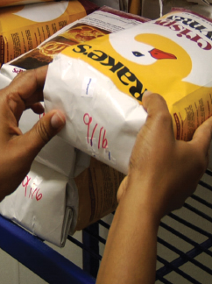
General Storage Guidelines
Rotation
First-in, first-out method (FIFO)
Temperature guidelines include:
Store TCS food at an internal temperature of 41°F or lower or 135°F or higher.
Store meat, poultry, seafood, and dairy in the coldest part of the unit.
Defrost freezers regularly.
Notes:
Instructor Notes
*This slide contains Core Food Safety content.

Slide 6
Preventing Cross-contamination
Guidelines to prevent cross-contamination in storage include:
Store food in a clean dry area away from contaminants.
Discard food that is damaged, spoiled, or incorrectly stored.
Store supplies in designated areas.
Store food in containers intended for food.
Notes:
Instructor Notes
*This slide contains Core Food Safety content.

Slide 7
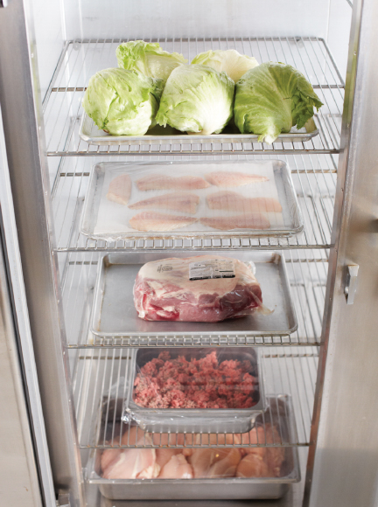
Preventing Cross-contamination
Storage Order
Safe food storage starts with wrapping or covering food.
After that, how you store the food depends on the type of food and your options for storage.
Notes:
Instructor Notes
*This slide contains Core Food Safety content.
Activity: Stock the Cooler
Knowledge Check
When must food be date marked?
Explain the FIFO method of stock rotation.

Slide 8
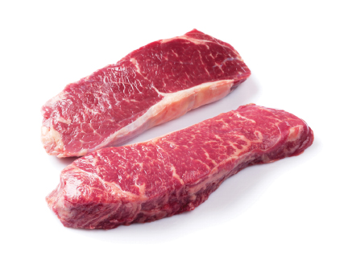
7.2 Storing Specific Types of Food
Meat
Temperature
Internal temperature of 41ºF or lower (fresh)
Containers/Location
Immediately after delivery and inspection, store meat in its own storage unit or in the coldest part of the cooler.

Slide 9
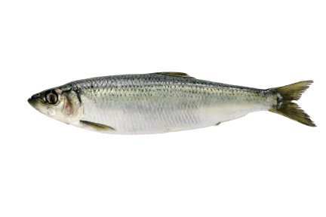
Storing Specific Types of Food
Fish
Temperature
Internal temperature of 41ºF or lower (fresh)
Containers/Location
Keep in original packaging or tightly wrap in moisture-proof materials.
Fresh, whole fish can be packed in flaked or crushed ice.

Slide 10
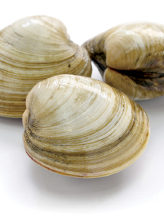
Storing Specific Types of Food
Shellfish
Temperature
Internal temperature of 41ºF or lower (shucked)
Air temperature of 41ºF or lower (live)
Containers/Location
Store live shellfish in original container.
Do not remove the shellstock tag from the container.

Slide 11
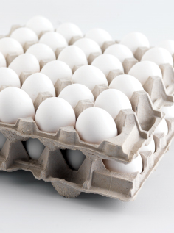
Storing Specific Types of Food
Eggs
Temperature
Air temperature of 45ºF or lower
Containers/Location
Do not wash before storing.
Keep shell eggs in cold storage and take out only as many as needed for immediate use.

Slide 12
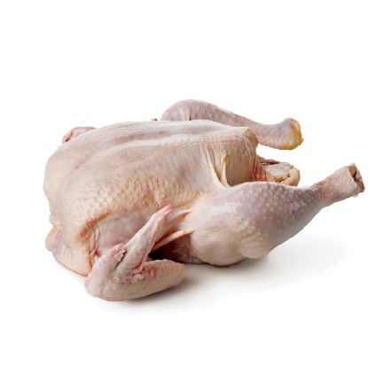
Storing Specific Types of Food
Poultry
Temperature
Internal temperature of 41ºF or lower (fresh)
Containers/Location
If the poultry has been removed from its original packaging, place it in an airtight container or wrap it in airtight material.
Ice-packed poultry can be stored in a cooler as is.

Slide 13
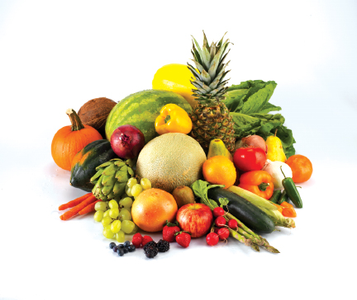
Storing Specific Types of Food
Fresh Produce
Temperature
TCS foods: 41ºF or lower
Whole citrus, squash, eggplants, root vegetables: 60°F to 70°F
Containers/Location
Whole citrus, root vegetables, etc. can be in dry storage with well-ventilated containers.
Do not wash most produce before storage.

Slide 14
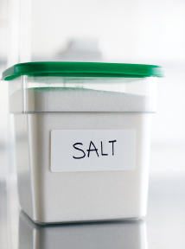
Storing Specific Types of Food
Dry food
Temperature
Low humidity
Containers/Location
Keep flour, cereal, and grain items in airtight containers.
Check containers/packages for damage from pests before using.
Notes:
Knowledge Check
What is one example of a produce item that is considered to be a TCS food?
Do all fruits and vegetables need to be stored at 41°F (5°C) or lower?

Slide 15
What is the recommended top-to-bottom order for storing the following food in the same cooler: raw trout, an uncooked beef roast, raw chicken, pecan pie, and raw ground beef?
What are the requirements for storing live shellfish?
Explain the labeling requirements for food packaged on-site for retail sale.
What is the maximum time that TCS food that was prepped in-house may be stored?
Notes:
Answers
1. What is the recommended top-to-bottom order for storing the following food in the same cooler: raw trout, an uncooked beef roast, raw chicken, pecan pie, and raw ground beef?
The recommended top-to-bottom order for storing the items in the same cooler is:
Pecan pie
Raw trout
Uncooked beef roast
Raw ground beef
Raw chicken
2. What are the requirements for storing live shellfish?
Live shellfish must be stored in its original container at an air temperature of 41°F (5°C) or lower. Shellstock identification tags must be kept on file for 90 days from the date the last shellfish was sold or served from the container.
3. Explain the labeling requirements for food packaged on-site for retail sale.
The label must include the following information:
Common name of the food or a statement that clearly identifies it.
Quantity of the food.
Ingredients and sub-ingredients in descending order by weight if the item contains two or more ingredients.
Artificial colors and flavors.
Chemical preservatives.
Name and place of business of the manufacturer, packer, or distributor.
Source of each major food allergen contained in the food. This is not necessary if the source is already part of the common name of the ingredient.
4. What is the maximum time that TCS food that was prepped in-house may be stored?
TCS food was prepped in-house can be stored for only seven days if held at 41°F (5°C) or lower. After that, it must be discarded.

