Slide 1
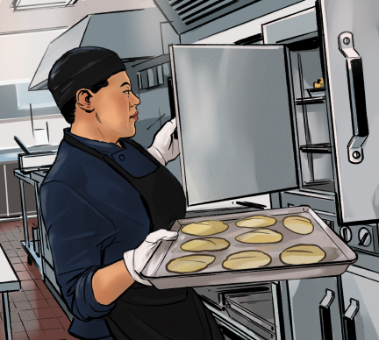
8
The Flow of Food: Preparation

Slide 2
Learning Objectives
State correct ways for prepping food to prevent cross-contamination and time-temperature abuse.
Describe safe methods for thawing food.
State the minimum internal cooking temperatures for TCS food.
Summarize the requirements to inform consumers of risks when serving raw or undercooked food.
Describe the requirements when cooking TCS food in a microwave and when partially cooking TCS food.
State methods and time-temperature requirements for cooling and reheating TCS food.
Notes:
Instructor Notes
Please review the Coursebook Instructor Change Document for important information on 2022 FDA Food Code changes related to this chapter. More information can be found at www.ServSafe.com/Academic

Slide 3
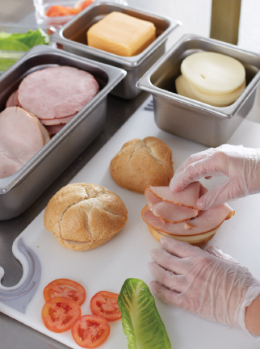
8.1 Preparation
Reduce the risk of time-temperature abuse and cross-contamination while prepping food:
  Make sure all equipment is clean and sanitized.
  Only remove as much food from the cooler as you can prep in a short period of time.
Notes:
Instructor Notes
*This slide contains Core Food Safety content.

Slide 4
General Preparation Practices
Return prepped food to the cooler or cook it ASAP.
Offer food in a way that does not mislead or misinform guests.
Follow guidelines if using food or color additives.
Corrective Actions
Food that has become unsafe should be thrown out unless it can be safely reconditioned.
Notes:
Instructor Notes
*This slide contains Core Food Safety content.
Activity: Food Safety Anti-Vision Board

Slide 5
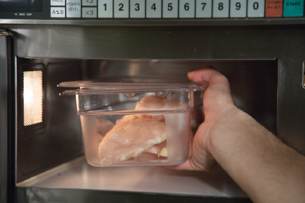
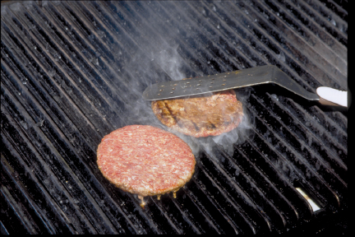
Thawing TCS Food
Thaw in a cooler, keeping its temperature at 41˚F or lower.
Submerge under running, drinkable water at 70˚F or lower.
Thaw in a microwave oven if it will be cooked immediately after.
Thaw as part of the cooking process.
ROP frozen fish should stay frozen until ready for use.
Notes:
Instructor Notes
*This slide contains Core Food Safety content.
Activity: Food Safety Anti-Vision Board

Slide 6
Prepping Specific Food #1
Meat, Seafood, and Poultry:
  Clean and sanitize.
  Prep separately from fresh produce.
  Remove only as much food as can be prepped at one time.
Salads containing TCS food:
  Prep in small batches.
  Only use leftover TCS ingredients that have been handled safely.
  Leave food in the cooler until all ingredients will be mixed.
Notes:
Instructor Notes
*This slide contains Core Food Safety content.

Slide 7
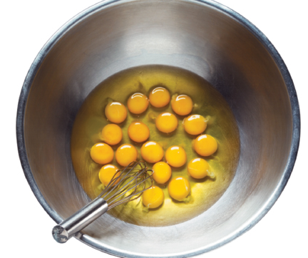
Prepping Specific Food #2
Eggs and Egg Mixtures
  Handle pooled eggs carefully.
  Use pasteurized eggs for undercooked dishes.
  Take special care with high-risk populations.
  Clean and sanitize.
Notes:
Instructor Notes
*This slide contains Core Food Safety content.

Slide 8
Prepping Specific Food #3
Batters and Breading
  Prep in small batches.
  Store promptly.
  Create a plan to throw out unused product.
  Ensure food is cooked thoroughly.
Fresh Juice
  Treat according to an approved HACCP plan.
  As an alternative, the juice can be labeled with a warning.

Slide 9
Prepping Specific Food #4
Produce
  Protect from surfaces exposed to raw meat, seafood, or poultry.
  Wash thoroughly.
  Refrigerate cut melons, cut tomatoes, and cut leafy greens at 41°F or lower.
Ice
Make from water that is safe to drink.
Never use ice used to keep food cold.
Use clean and sanitized containers and scoops.
Notes:
Instructor Notes
*This slide contains Core Food Safety content.

Slide 10
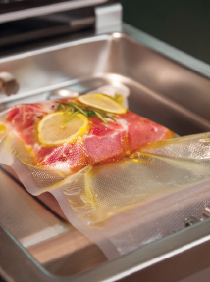
Prepping Practices with Special Requirements
Practices requiring a variance include:
Packaging fresh juice
Smoking food to preserve it
Packaging food using an ROP method
Sprouting seeds or beans
A shellfish display tank
You may be required to submit a HACCP plan when applying for a variance.
Notes:
Instructor Notes
*This slide contains Core Food Safety content.
Knowledge Check
Provide an example of food that cannot be safely reconditioned and must be thrown out.
Describe the guidelines when thawing food under running water.

Slide 11
8.2 Cooking Food
The only way to reduce pathogens in food to safe levels is to cook it to its correct minimum internal temperature.
Examples:
Poultry 165°F (74°C) for <1 second
Ground Meat 155°F (68°C) for 17 seconds
Food from plants for 135°F (57°C) (no minimum time)
In a microwave, meat, seafood, poultry, and eggs must be cooked to 165°F (74°C)
Notes:
Instructor Notes
*This slide contains Core Food Safety content.

Slide 12
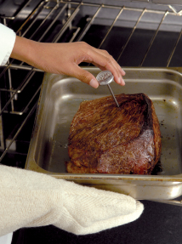
Cooking Food
  General cooking guidelines:
  Specify the cooking time and minimum internal temperature in all recipes.
  Use thermometers correctly.
  Avoid overloading cooking equipment.
  Let the temperature of cooking equipment recover between batches.
Notes:
Instructor Notes
*This slide contains Core Food Safety content.

Slide 13
Consumer Safety
Consumer Advisories
Disclose any raw or undercooked TCS items on the menu.
Advise customers of the increased risk of foodborne illness.
Do not offer raw or undercooked meat, poultry, seafood, or eggs on a children’s menu.
Operations serving high-risk populations should never serve:
  Raw seed sprouts
  Raw or undercooked eggs, meat, or seafood
  Unpasteurized milk or juice
Notes:
Instructor Notes
*This slide contains Core Food Safety content.

Slide 14
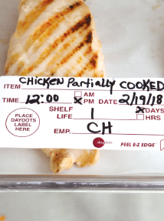
Partial Cooking During Prepping
When partially cooking meat, seafood, poultry, eggs:
Initial cooking should not exceed 60 min.
Cool the food immediately.
Freeze or refrigerate the food after cooling.
Heat the food to its required minimum internal temperature.
Cool the food if it will not be served immediately or held for service.
Notes:
Instructor Notes
*This slide contains Core Food Safety content.
Knowledge Check
The FDA recommends cooking certain food items to a minimum internal temperature of 145°F (63°C) for 15 seconds. Name at least two of these foods.
The FDA advises against including certain items on children’s menus. What are they?

Slide 15
8.3 Cooling and Reheating Food
Cool TCS food from 135°F to 41°F (57°C to 5°C) or lower within six hours.
Cool food from 135ºF to 70ºF within two hours.
Cool it from 70ºF to 41ºF or lower in the next four hours.
Factors that can affect how quickly food cools:
Thickness/density of food
Size of food
Storage container
Notes:
Instructor Notes
*This slide contains Core Food Safety content.

Slide 16
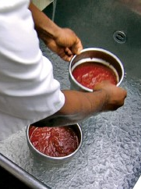
Cooling Food
Methods for Cooling Food
Ice-water bath
Ice paddle
Blast or tumble chiller
Ice or cold water as an ingredient
Loosely cover containers if storing for further cooling.
Notes:
Instructor Notes
*This slide contains Core Food Safety content.

Slide 17
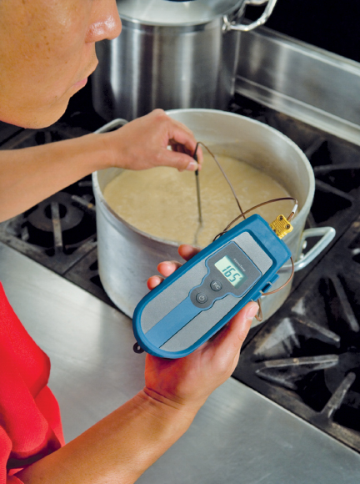
Reheating Food
Reheating for immediate service:
Reheat food to any temperature if served immediately.
Reheating for hot holding.
Reheat TCS food to an internal temperature of 165°F for 15 seconds.
Reheat commercially processed and packaged ready-to-eat food to an internal temperature of at least 135°F.
Notes:
Instructor Notes
*This slide contains Core Food Safety content.
Knowledge Check
When cooling food, what are the time and temperature requirements for each stage?
For items that will be hot held, what is the minimum internal temperature required when reheating commercially processed and packaged ready-to-eat food such as deep-fried mushrooms?
Activity: Recipe Roadmap

Slide 18
Discussion Questions
What are the minimum internal cooking temperatures for poultry, fish, pork, and ground beef?
What are the four correct methods for thawing food?
What methods can be used to cool cooked food?
What actions should an operation take when a guest asks for an undercooked item, such as a rare hamburger?
For operations that serve high-risk populations, what special care must be taken when serving eggs?
Notes:
Answers
1. The minimum internal cooking temperatures are:
Poultry: 165°F (74°C) for <1 second (instantaneous)
Fish: 145°F (63°C) for 15 seconds
Pork: 145°F (63°C) for 15 seconds (roasts for four minutes)
Ground beef: 155°F (68°C) for 17 seconds
2. The four correct methods for thawing food are:
Thaw it in a refrigerator at a product temperature of 41°F (5°C) or lower.
Submerge it under running, drinkable water at a temperature of 70°F (21°C) or lower.
Thaw it in a microwave oven if it will be cooked immediately afterward.
Thaw it as part of the cooking process as long as the product reaches the required minimum internal cooking temperature.
3. There are a number of methods that can be used to cool food, including:
Using ice-water baths
Stirring food with an ice paddle
Using a blast chiller or tumble chiller
Adding ice or cold water as an ingredient
4. You must cook TCS food to required minimum internal temperatures listed in this chapter unless a customer requests otherwise. Some operations will not provide raw or undercooked items. If an operation does choose to offer undercooked menu items such as rare hamburgers upon customer request, there are additional steps to take. If your menu includes TCS items that are raw or undercooked, you must note it on the menu next to these items or by placing an asterisk next to the item that points guests to a footnote. The footnote must include a statement that indicates the item is raw or undercooked, or contains raw or undercooked ingredients. You must advise guests who order TCS food that is raw or undercooked, such as animal products, of the increased risk of foodborne illness. One way to do this is by posting a notice in your menu. You can also provide this information using brochures, table tents, signs, or other approved alternative methods. The FDA advises against offering raw or undercooked meat, poultry, seafood, or eggs on a children’s menu.
5. Undercooked, unpasteurized shell eggs must not be served to high-risk populations. Operations that primarily serve high-risk populations should use pasteurized eggs or egg products when dishes containing eggs will be served raw or undercooked. Shell eggs that are pooled must also be pasteurized. Unpasteurized shell eggs may be used if the dish will be cooked all the way through, such as in an omelet or a cake.

