Slide 1
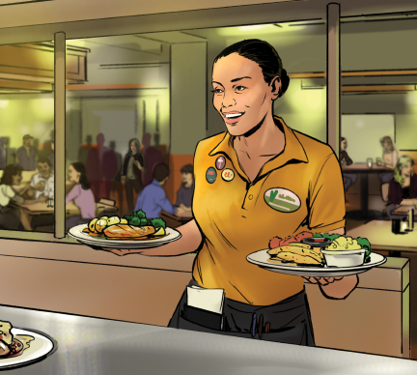
9
The Flow of Food: Service

Slide 2
Learning Objectives
After completing this chapter, you should be able to:
Identify ways to prevent time-temperature abuse when holding and serving food.
Explain how to protect ready-to-eat food from contamination during preparation, display, and service.
Describe the requirements for off-site catering and food transportation to prevent contamination and time-temperature abuse.
Describe how to handle utensils and equipment to prevent contamination.

Slide 3
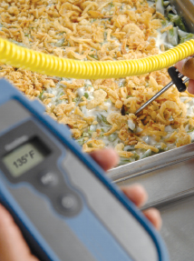
9.1 Holding Food for Service
General Rules for Holding Food
Hold at the correct internal temperature.
  Use a thermometer to check at least once every four hours.
Never use hot-holding equipment to reheat food.
Cover food and install sneeze guards.
Create policies for how long to hold food and when to throw it out.
Notes:
Instructor Notes
*This slide contains Core Food Safety content.

Slide 4
Holding Cold Food without Temperature Control
Cold food can be held without temperature control for up to six hours if certain condition are met including:
  It was held at 41ºF (5ºC) or lower before removed from refrigeration.
  It does not exceed 70ºF (21ºC) during service.
  It has a label specifying when it was removed from refrigeration and when it must be thrown out.
There are alternative requirements for holding cold ready-to-eat TCS food without temperature control.
Notes:
Instructor Notes
*This slide contains Core Food Safety content.

Slide 5
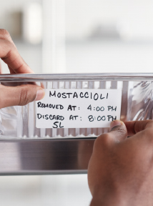
Holding Hot Food without Temperature Control
Hot food can be held without temperature control for up to four hours if:
It was held at 135ºF (57ºC) or higher before removed from temperature control.
It has a label specifying when it must be thrown out.
It is sold, served, or thrown away within four hours.
Notes:
Instructor Notes
*This slide contains Core Food Safety content.
Knowledge Check
Why should hot-holding equipment never be used to reheat food?
Name an example of a situation in which food might be held without temperature control.

Slide 6
9.2 Serving Food Safely
Steps to prevent contamination during food service include:
Wrapping or covering preset silverware
Training service staff on guidelines around glasses, dishes, and utensils such as:
  Hold dishes by the bottom or edge.
  Do not stack glasses when carrying.
  Avoid bare hand contact with ready-to-eat food.
Notes:
Instructor Notes
*This slide contains Core Food Safety content.

Slide 7
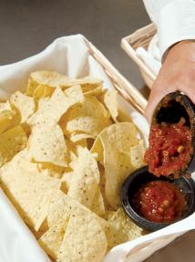
Serving Food Safely
Never re-serve:
Food returned by a guest
Plate garnishes
Uneaten bread
Uncovered condiments
Only re-serve unopened, prepackaged food in good condition.
Notes:
Instructor Notes
*This slide contains Core Food Safety content.

Slide 8
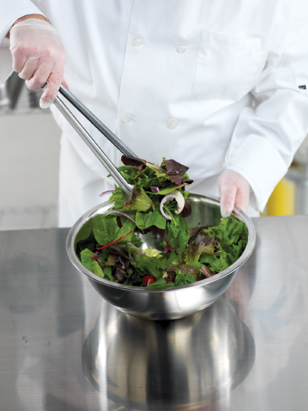
Serving Food Safely: Kitchen
Guidelines for kitchen staff include:
Avoid bare hand contact with ready-to-eat food.
Use separate, clean, sanitized utensils for each food item.
Store serving utensils correctly between use.
Refill take-home containers only if they meet certain conditions.
Notes:
Instructor Notes
*This slide contains Core Food Safety content.
Food handlers are allowed to refill take-home containers in some jurisdictions.

Slide 9
Serving Food Safely: Self-Service
Guidelines for self-service areas include:
Use sneezeguards, display cases, or packaging.
Use labels to identify food items.
  Bulk food labeling
Do not offer raw meat, poultry, or seafood for self-service.
Do not let guests reuse dirty plates or utensils.
Provide correct utensils.
Never use ice used to keep food or beverages cold as an ingredient.
Notes:
Instructor Notes
*This slide contains Core Food Safety content.
Knowledge Check
Name three items that should never be re-served to guests.
How can food be protected in a self-service area?

Slide 10
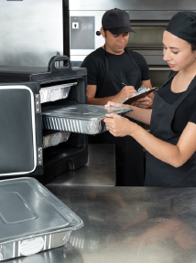
9.3 Off-Site Service
Guidelines for safe food delivery:
Pack in insulated, food-grade containers.
Label with dates and instructions.
Clean inside of delivery vehicles.
Practice good personal hygiene.
Check internal food temperatures.
Store raw meat, poultry, and seafood separately from ready-to-eat food.
Notes:
Instructor Notes
*This slide contains Core Food Safety content.

Slide 11
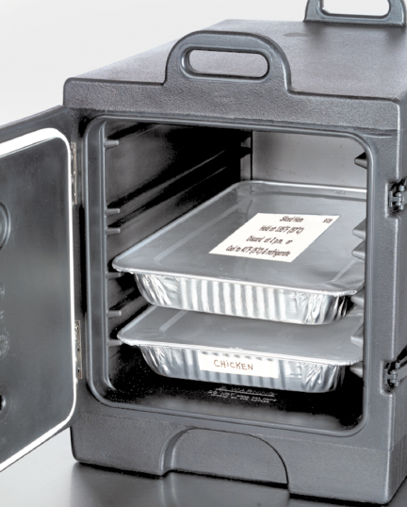
Off-Site Service: Catering
Food safety guidelines for catering:
Make sure service site has correct utilities.
Store and serve cold and TCS foods in the appropriate containers.
Store raw meat, poultry, and seafood separately from ready-to-eat food.
Provide guests with handling instructions for leftover food
Notes:
Instructor Notes
*This slide contains Core Food Safety content.

Slide 12
Off-Site Service: Other
Temporary Units
Construct to keep out dirt and pests.
Ensure safe drinking water is available.
Mobile Units
  Sanitation requirements may vary based on the products.
  Special permit or license may be needed.
  Temporary and mobile units must follow the same safety rules as permanent food operations.

Slide 13
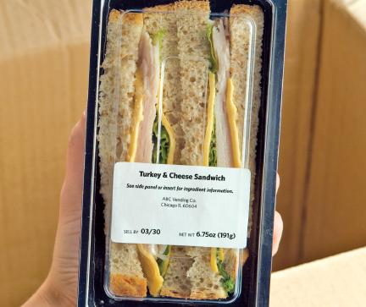
Off-Site Service: Vending Machines
Vending Machines
Check product shelf life daily.
Keep TCS food at correct temperature.
Dispense TCS food in original containers.
Wash and wrap fruit with edible peels.
Notes:
Instructor Notes
*This slide contains Core Food Safety content.
Activity: To Serve and Prevent
Knowledge Check
Name three examples of off-site services.
What are the requirements for containers used to transport food?

Slide 14
What can be done to minimize contamination in self-service areas?
What hazards are associated with the transportation of food and how can they be prevented?
What are the requirements for using time rather than temperature as the only method of control when holding TCS food?
What practices should be followed to serve catered food off-site?
How can vending operators protect food from contamination and time-temperature abuse?
Notes:
Answers
1. What can be done to minimize contamination in self-service areas?
To minimize contamination in self-service areas:
• Protect food on display using sneeze guards, display cases, or packaging.
• Label food located in self-service areas.
• Prevent guests from refilling dirty plates or using dirty utensils at self-service areas.
• Stock food displays with the correct utensils for dispensing food.
2. What hazards are associated with the transportation of food and how can they be prevented?
The longer the time between preparation and consumption, the greater the risk that food will be exposed to contamination or time-temperature abuse. To prevent these hazards, do the following:
• Pack food in insulated food-grade containers. They should be designed so food cannot mix, leak, or spill.
• Clean the inside of delivery vehicles regularly.
• Practice good personal hygiene when distributing food.
• Check internal food temperatures. If containers or delivery vehicles are not maintaining the correct temperature, reevaluate the length of the delivery route or the efficiency of the equipment being used.
• Label food with a use-by date and time and with reheating and service instructions for staff at off-site locations.
• Store raw meat, poultry, and seafood and ready-to-eat items separately.
3. What are the requirements for using time rather than temperature as the only method of control when holding TCS food?
TCS food can be displayed or held without temperature control under the following conditions:
It is not for a primarily high-risk population.
Cold Food
• It was held at 41°F (5°C) or lower before removing it from refrigeration.
• It does not exceed 70°F (21°C) while it is being served.
• It has a label that specifies both the time it was removed from refrigeration and the time it must be thrown out.
• It is sold, served, or thrown out within six hours.
• If the food is discarded within four hours, it can be allowed to reach any temperature during service.
Hot Food
• It was held at 135°F (57°C) or higher before removing it from temperature control.
• It has a label that specifies when the item must be thrown out.
• It is sold, served, or thrown out within four hours.
4. What practices should be followed to serve catered food off-site?
When serving catered food off-site:
• Ensure there is safe water for cooking, dishwashing, and handwashing.
• Make sure garbage is stored away from food-prep, storage, and serving areas.
• Store food properly. Use insulated containers to hold TCS food. Wrap raw meat and store it on ice. Deliver dairy products in a refrigerated vehicle or on ice. Store ready-to-eat food separately from raw meat, poultry, and seafood.
• Serve cold food in containers on ice or in chilled, gel-filled containers, or hold the food without temperature control according to guidelines.
• Label any leftovers given to guests. Provide instructions for storage and reheating and a discard date.
5. How can vending operators protect food from contamination and time-temperature abuse?
To protect food from contamination and time-temperature abuse, vending operators can do the following:
Check product shelf life daily and dispose of any expired food.
Keep TCS food at the correct temperature.
Dispense TCS food in its original container.
Wash and wrap fresh fruit with edible peels before putting it in a machine.

