Slide 1
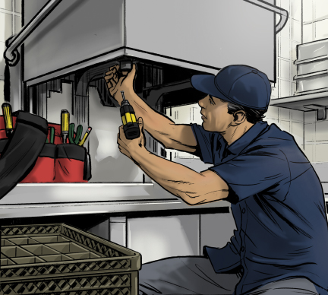
11
Safe Facilities and Equipment

Slide 2
Learning Objectives
Describe the proper operation of facilities and equipment.
Explain requirements for installing equipment.
Identify requirements for handwashing sinks and accessibility.
List requirements for proper garbage and biohazard removal.
Identify whether equipment meets approved standards for foodservice equipment.
Notes:
Instructor Notes
Please review the Coursebook Instructor Change Document for important information on 2022 FDA Food Code changes related to this chapter. More information can be found at www.ServSafe.com/Academic

Slide 3
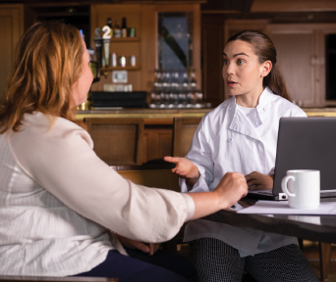
11.1 Designing a Safe Operation
Construction Plan Review
Construction plans require approval from the regulatory authority.
Ensures design meets requirements.
Ensures the safe flow of food.
Can save time and money.

Slide 4
Layout
A well-designed kitchen:
has a workflow that minimizes the time food is in the temperature danger zone and how often it is handled,
positions equipment to minimize opportunities for cross-contamination
makes equipment accessible for regular cleaning.

Slide 5
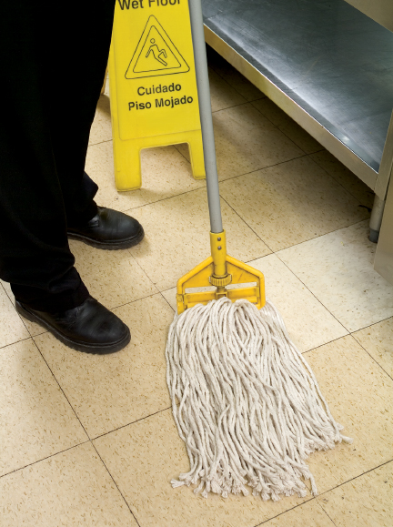
Materials for Interior Construction
Each area of the operation will have its own flooring needs.
Nonporous, resilient flooring
Examples: vinyl or rubber tiles
Slippery when wet
Good for locker rooms and offices
Notes:
Instructor Notes
*This slide contains Core Food Safety content.

Slide 6
Flooring
Hard-surface flooring
Examples: marble, quarry tiles, wood
Good for public restrooms and high-dirt areas
Carpeting
Not recommended for high-dirt areas
Special Flooring Needs
Use non-slip surfaces
Coving is required for resilient and hard-surface flooring materials
Notes:
Instructor Notes
*This slide contains Core Food Safety content.

Slide 7
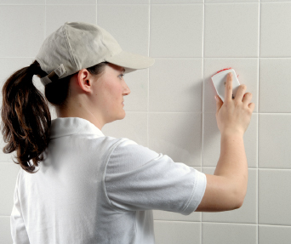
Finishes for Interior Walling and Ceilings
Interior finishes should be:
Smooth
Nonabsorbent
Durable
Easy to clean
Notes:
Knowledge Check
Which three factors will be addressed by a well-designed kitchen layout?
Name four qualities that flooring should have for most areas of the operation.

Slide 8
11.2 Considerations for Other Areas
Dry Storage
Construct with easy-to-clean materials.
Avoid direct sunlight.
Eliminate conduits.
Keep pests out by sealing cracks and installing screens.
Sinks and Handwashing
Handwashing stations are required
in or next to restrooms,
in food prep, service, and dishwashing areas.
Use each sink for its intended purpose to prevent cross-contamination.
Notes:
Instructor Notes
*This slide contains Core Food Safety content.

Slide 9
Considerations for Other Areas
Restrooms
Design so that patrons do not pass through prep areas to access.
Dressing Rooms and Lockers
Do not use areas for food prep, storage, or utensil washing.
Premises
Parking lots and walkways should be graded and surfaced.
Do not allow use for living or sleeping.
Notes:
Knowledge Check
Why should windows in dry-storage areas have frosted glass or shades?
Why must staff use each sink in an operation for its intended use?
Activity: Construction Competition

Slide 10
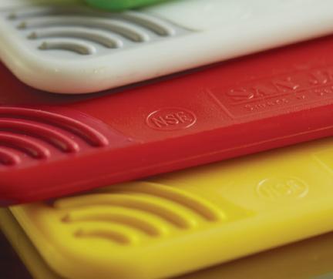
11.3 Equipment Selection
Equipment Standards
Purchase equipment that has the:
NSF mark
UL EPH classified mark
ETL sanitation mark
Notes:
Instructor Notes
*This slide contains Core Food Safety content.

Slide 11
Dishwashing Machines
Dishwashers common in food service operations include:
Single-tank, stationary-rack machine, with doors
Conveyor machine
Carousel or circular-conveyor machine
Flight type
Batch-type, dump
Recirculating, door-type, non-dump machine

Slide 12
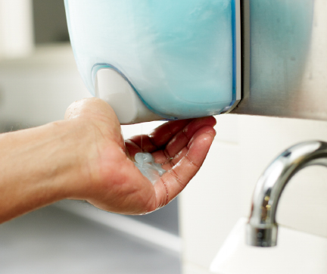
Dishwasher Selection and Installation
Installation
Install in a convenient location and raise at least six inches from the floor.
Water pipes should be as short as possible.
Use approved detergents and sanitizers.
Notes:
Instructor Notes
*This slide contains Core Food Safety content.

Slide 13
Dishwashers and Sinks
Purchase dishwashers that:
measure water temperature, pressure, and chemical concentration,
have readable thermometers; increments are no greater than 2°F (1°C), and
are easy to clean.
Purchase three-compartment sinks that can accommodate large equipment and utensils.
Notes:
Instructor Notes
*This slide contains Core Food Safety content.

Slide 14
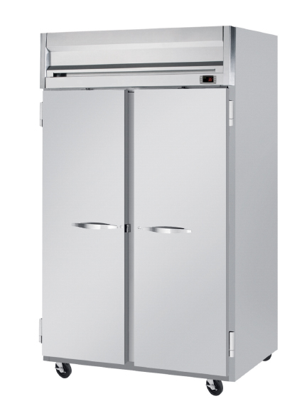
Cooler and Freezers
Consider these factors when purchasing a cooler or freezer unit:
Walk-in units can be sealed to the floor and wall.
Reach-in units have legs to elevate them at least six inches from the floor.
Built-in thermometers are easy to read and locate; they are accurate within ±3°F.

Slide 15
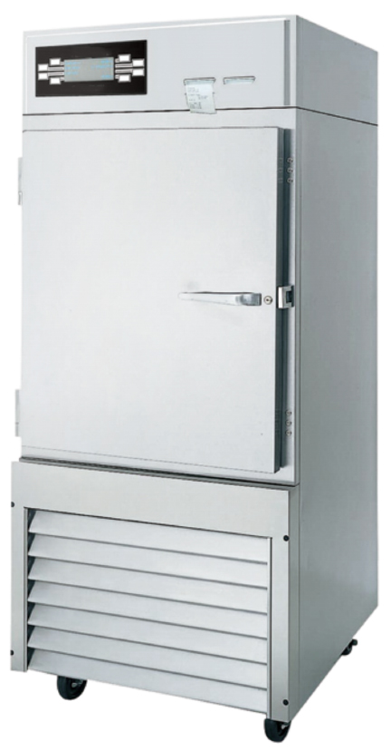
Other Equipment
Blast Chillers and Tumble Chillers
Used to cool food quickly
Cook-Chill Equipment
An integrated piece of equipment that can cook, cool, and reheat food
Cutting Boards
If allowed by the regulatory authority, wooden cutting boards must be nonabsorbent, non-toxic, and smooth.
Notes:
Knowledge Check
When comparing dishwashing machines, what is the difference between high-temperature machines and chemical-sanitizing machines?
Name two pieces of equipment that can cool food quickly.

Slide 16
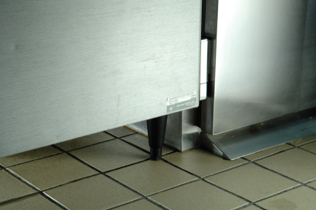
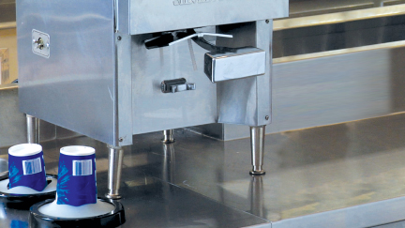
11.4 Installing and Maintaining Kitchen Equipment
Floor-mounted equipment
Must be at least six inches from the floor
Tabletop equipment
Must be elevated four inches or sealed to the countertop
Make sure equipment is maintained regularly by qualified people.
Notes:
Instructor Notes
*This slide contains Core Food Safety content.
Knowledge Check
What are the requirements for installing floor mounted, stationary equipment?
What are the requirements for installing tabletop, stationary equipment?

Slide 17
11.5 Utilities
Sources of potable water:
Approved public water mains
Regularly tested and maintained private sources
Closed, portable water containers
Water transport vehicles
Hot water
Most general-purpose water heaters do not heat water to temperatures required for hot-water sanitizing.
Notes:
Instructor Notes
*This slide contains Core Food Safety content.

Slide 18
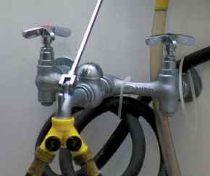
Plumbing
A cross-connection is a physical link between safe water and dirty water.
Can cause backflow
Backflow Prevention
Vacuum breaker
Air gap
Notes:
Instructor Notes
*This slide contains Core Food Safety content.

Slide 19
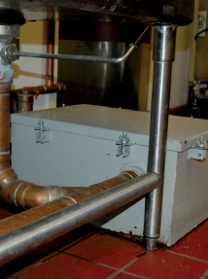
Plumbing Continued
Grease traps can be installed to prevent drain blockage.
Check pipes regularly so they do not leak and contaminate food.
Prevent sewage and wastewater from contaminating food and food-contact surfaces.
Notes:
Instructor Notes
*This slide contains Core Food Safety content.

Slide 20
Lighting and Ventilation
Lighting
Measured in foot-candles or lux
Different areas have different lighting-intensity requirements.
Ventilation
Improves the air inside the operation
Clean and maintain ventilation systems according to the manufacturer’s recommendations.
Notes:
Instructor Notes
*This slide contains Core Food Safety content.

Slide 21
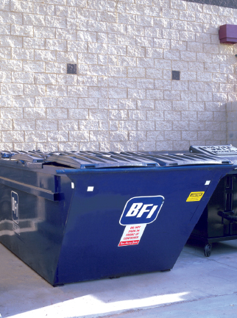
Garbage
Remove from prep areas quickly.
Clean garbage containers frequently.
Indoor containers must be leakproof, waterproof, and pest-proof.
Store waste and recyclables separately from food and food-contact surfaces.
Place outdoor containers on smooth, durable, nonabsorbent surfaces.
Notes:
Instructor Notes
*This slide contains Core Food Safety content.
Knowledge Check
What risks do backflow and backsiphonage present to food safety?
How does proper ventilation improve the air inside of an operation?

Slide 22
What is one of the most important considerations when choosing flooring for food-preparation areas?
What action must be taken in the event of a backup of raw sewage in an operation?
What actions can be taken to control contamination from garbage in an operation?
What can be done to prevent backflow in an operation?
What are some approved water sources for an operation? What are the testing requirements for nonpublic water systems?
What are the requirements of a handwashing station? In what areas of an operation are handwashing stations required?
Notes:
Answers
1. What is one of the most important considerations when choosing flooring for food-preparation areas?
One of the most important considerations when selecting flooring for food-preparation areas is the material’s porosity, or the extent to which it will absorb liquids. Avoid high porosity flooring. Its absorbency often makes it ideal for pathogen growth. Flooring should also be smooth, durable, and easy to clean. It should resist wear and help prevent slips.
2. What action must be taken in the event of a backup of raw sewage in an operation?
A backup of raw sewage in an operation is cause for immediate closure of the area, correction of the problem, and thorough cleaning. If the backup is a significant risk to the safety of food, service must be stopped. Then the local regulatory authority must be notified.
3. What actions can be taken to control contamination from garbage in an operation?
The following can help control contamination from garbage:
Garbage should be removed from prep areas as quickly as possible to prevent odors, pests, and possible contamination.
Clean the inside and outside of garbage containers frequently.
Indoor containers must be leakproof, waterproof, and pest-proof. They also should be easy to clean.
Waste and recyclables must be stored separately from food and food-contact surfaces.
Place outdoor garbage containers on a surface that is smooth, durable, and nonabsorbent. Keep lids closed and drain plugs in place.
4. What can be done to prevent backflow in an operation?
To prevent backflow in an operation:
Avoid creating a cross-connection. Do not attach a hose to a faucet unless a backflow prevention device, such as a vacuum breaker, is attached.
Install air gaps where necessary. This is the only sure way to prevent backflow. An air gap is an air space that separates a water supply outlet from a potentially contaminated source.
5. What are some approved water sources for an operation? What are the testing requirements for nonpublic water systems?
Sources of approved water include:
• Approved public water mains
• Private water sources regularly maintained and tested
• Closed portable water containers
• Water transport vehicles
If an operation uses a private water supply, such as a well, rather than an approved public source, it should check with the local regulatory authority for information on inspections, testing, and other requirements. Nonpublic water systems should be tested at least annually, and the report kept on file in the operation.
6. What are the requirements of a handwashing station? In what areas of an operation are handwashing stations required?
The requirements of a handwashing station include:
• Hot and cold running water that is drinkable and meets temperature and pressure requirements.
• Soap in liquid, bar, or powder form.
• A way to dry hands. Disposable paper towels or a continuous towel system that supplies the user with a clean towel can be used. Hands can also be dried with a hand dryer using either warm air or room-temperature air delivered at high velocity.
• A garbage container. This is required if disposable paper towels are used.
• A clearly visible sign or poster that tells staff to wash hands before returning to work. The message should be in all languages used by staff in the operation.
Handwashing stations are required in restrooms or directly next to them. Handwashing stations are also required in areas used for food prep, service, and dishwashing. Handwashing sinks must be used only for handwashing and not for any other purpose. Make sure adequate barriers are present on handwashing sinks or that there is an adequate distance between handwashing sinks and food and food-contact surfaces. Make sure these stations work correctly and are well stocked and maintained. They must also be available at all times. Handwashing stations cannot be blocked by portable equipment or stacked full of dirty kitchenware.

