Slide 1
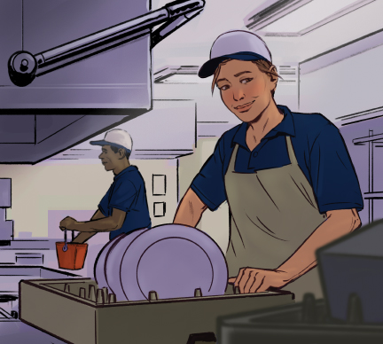
12
Cleaning and Sanitizing

Slide 2
Learning Objectives
Describe how and when to clean and sanitize food contact surfaces and equipment.
Describe how to clean and sanitize items in a dishwashing machine and three-compartment sink.
Explain how and when to clean nonfood contact surfaces.
Identify different types of cleaners and their uses.
Describe different methods of sanitizing and their correct use.
Explain the requirements for safely using and storing cleaning tools and chemicals.
Summarize how to develop a cleaning program.

Slide 3
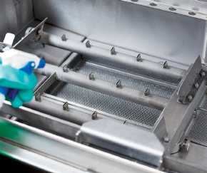
12.1 Cleaning
Factors that affect cleaning:
Type and condition of dirt
Water hardness
Water temperature
Surface
Agitation or pressure
Length of treatment

Slide 4
Types of Cleaners
Guidelines for cleaners
Always follow the manufacturer’s directions and only use cleaners for their intended purpose.
Four Categories:
Detergents
Degreasers
Delimers
Abrasive cleaners
Notes:
Instructor Notes
*This slide contains Core Food Safety content.
Knowledge Check
Name at least three factors that can affect the cleaning process.
Which type of cleaner would be the best choice when cleaning burned on grease from a grill backsplash?
Activity: Dirty Kitchen Gallery Walk

Slide 5
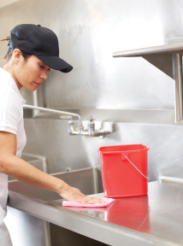
12.2 Sanitizing
Heat Sanitizing
Immerse item in water that is at least 171˚F (77˚C) for at least 30 seconds.
Chemical Sanitizing
Soak item in a sanitizing solution.
Rinse, swab, or spray item with a sanitizing solution.
Notes:
Instructor Notes
*This slide contains Core Food Safety content.
Sanitizers must be provided to employees and available during all hours of the operation.

Slide 6
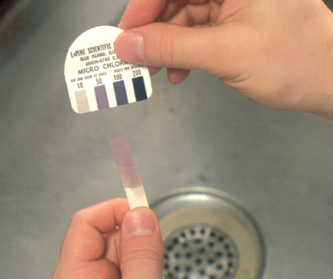
Sanitizer Effectiveness
Factors that can impact a sanitizer’s effectiveness:
Concentration
Temperature
Contact time
Water hardness
pH
Notes:
Instructor Notes
*This slide contains Core Food Safety content.

Slide 7
How and When to Clean and Sanitize
How to sanitize a surface:
Remove food bits
Wash
Rinse
Sanitize
Air-dry
Surfaces that do not touch food only need to be cleaned and rinsed.
A surface that touches food must be cleaned, rinsed, and sanitized.
Notes:
Instructor Notes
*This slide contains Core Food Safety content.

Slide 8
When to Clean and Sanitize a Food Contact Surface
A food-contact surface should be sanitized:
After use
Before working with a different type of food
After handling different raw TCS fruits and vegetables
Any time a task was interrupted and items may have been contaminated
After four hours if in constant use
Notes:
Instructor Notes
*This slide contains Core Food Safety content.

Slide 9
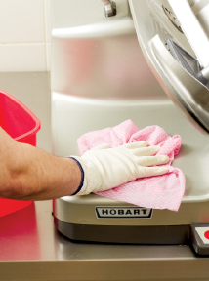
How to Clean and Sanitize
Cleaning Stationary Equipment
Follow manufacturer’s directions.
Clean-in-Place Equipment
Equipment that holds and dispenses TCS food must be cleaned and sanitized every day unless otherwise indicated by the manufacturer.
Notes:
Instructor Notes
*This slide contains Core Food Safety content.
Knowledge Check
1. When heat sanitizing items by soaking them in hot water, what are the time and temperature requirements?
2. What are the five steps to properly clean and sanitize a food contact surface such as a prep table?

Slide 10
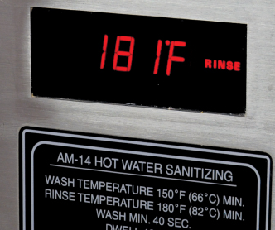
12.3 Dishwashing
High-Temperature Machines
Final sanitizing rinse must be at least 180°F (82°C)
Chemical-Sanitizing Machines
Can clean and sanitize at much lower temperatures
Notes:
Instructor Notes
*This slide contains Core Food Safety content.

Slide 11
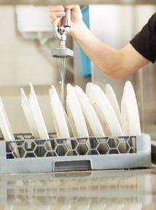
Dishwashing Operation Guidelines
Clean the machine as often as needed.
Scrape items before washing.
Use the correct dish racks and never overload racks.
Air-dry all items.
Check water temperature, pressure, and sanitizing levels.
Notes:
Instructor Notes
*This slide contains Core Food Safety content.

Slide 12
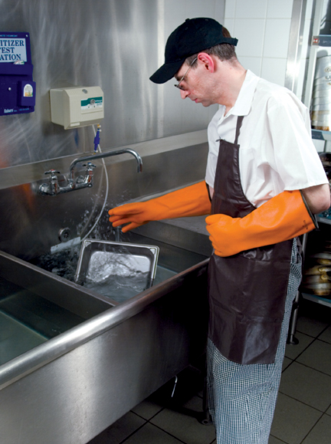
Manual Dishwashing
Prepare a three-compartment sink by correctly setting up each compartment.
To clean and sanitize:
Scrape items.
Wash items in the first sink.
Rinse items in the second sink.
Sanitize items in the third sink.
Air dry on a clean, sanitized surface.
Notes:
Instructor Notes
*This slide contains Core Food Safety content.

Slide 13
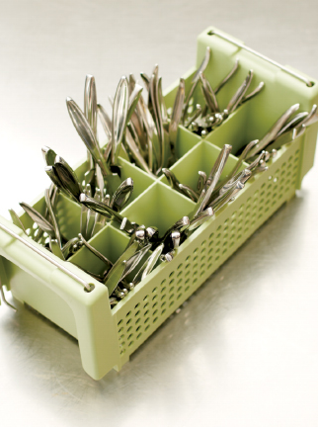
Storing Tableware and Equipment
Store at least six inches from the floor.
Clean and sanitize drawers and shelves.
Store glasses upside down and flatware with handles up.
Clean and sanitize trays and carts used to carry clean tableware and utensils.
Cover the food-contact surfaces of stationary equipment until ready for use.
Notes:
Instructor Notes
*This slide contains Core Food Safety content.
Knowledge Check
After cleaning and sanitizing glasses and cups, how should they be stored?
How should a three-compartment sink be prepared for dishwashing?

Slide 14
12.4 Cleaning the Premises
Using wiping cloths
Wet: use to wipe counters and other surfaces.
Dry: use to wipe food spills from tableware.
Non-food contact surfaces
Need to be cleaned regularly but not sanitized
Diarrhea and vomit must be cleaned up immediately.
Notes:
Instructor Notes
*This slide contains Core Food Safety content.

Slide 15
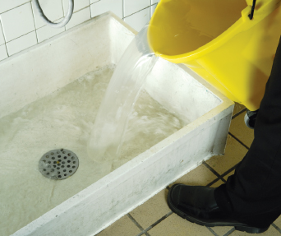
Using and Storing Cleaning Tools and Supplies
Store cleaning tools in a designated area away from food. Include:
Good lighting
Hooks
Utility sink
Floor drain
Notes:
Instructor Notes
*This slide contains Core Food Safety content.

Slide 16
Using Foodservice Chemicals
Guidelines for using foodservice chemicals safely include:
Only use chemicals approved for use in a foodservice operation.
Store chemicals in original containers:
  below food, equipment, utensils, and linens.
Keep the original manufacturer’s label with directions.
Notes:
Instructor Notes
*This slide contains Core Food Safety content.
Knowledge Check
Which area of the operation must always have its own, separate set of cleaning tools?
Which surfaces in the operation do not require sanitizing?

Slide 17
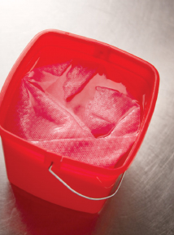
12.5 Developing a Cleaning Program
Identify cleaning needs.
Create a master cleaning schedule.
  What should be cleaned.
  Who should clean it.
  When it should be cleaned.
  How it should be cleaned.
Notes:
Instructor Notes
*This slide contains Core Food Safety content.

Slide 18
Developing a Cleaning Program
Choose cleaning Materials
See tasks in the master cleaning schedule.
Replace worn tools.
Provide staff with protective gear.
Implement the cleaning program
Have a kickoff meeting.
Schedule time for training.
Motivate your staff.
Monitor to ensure it’s working.
Notes:
Instructor Notes
*This slide contains Core Food Safety content.
Knowledge Check
What is the first step in developing a cleaning program?
What are four components that should be included in a master cleaning schedule?

Slide 19
When should food-contact surfaces be cleaned and sanitized?
What are the minimum temperatures required to sanitize dishes in a high-temperature dishwashing machine?
What are the steps that should be taken (in order) when cleaning and sanitizing items in a three-compartment sink?
How should clean and sanitized tableware, utensils, and equipment be stored?
What factors affect the effectiveness of a sanitizer?
Notes:
When should food-contact surfaces be cleaned and sanitized?
Food-contact surfaces must be cleaned and sanitized at the following times:
After they are used
Before working with a different type of food
After handling different raw TCS fruits and vegetables
Any time there is an interruption during a task and the items being used may have been contaminated
After four hours if items are in constant use
2. What are the minimum temperatures required to sanitize dishes in a high-temperature dishwashing machine?
In a high-temperature dishwashing machine, the temperature of the final sanitizing rinse must be at least 180°F (82°C). For stationary-rack, single-temperature machines, it must be at least 165°F (74°C). The dishwasher must have a built-in thermometer that checks water temperature at the manifold. This is where the water sprays into the tank.
3. What are the steps that should be taken (in order) when cleaning and sanitizing items in a three-compartment sink?
These are the steps that must be taken when cleaning and sanitizing items in a three-compartment sink:
1. Scrape items before washing them. If necessary, rinse or soak items.
2. Wash items in the first sink. Use a brush, cloth towel, or nylon scrub pad to loosen dirt. Change the water and detergent when the suds are gone or the water is dirty.
3. Rinse items in the second sink. Spray the items with water or dip them in it. Make sure to remove all traces of food and detergent from the items being rinsed. If dipping the items, change the rinse water when it becomes dirty or full of suds.
4. Sanitize items in the third sink. Change the sanitizing solution when the temperature of the water or the sanitizer concentration falls below requirements. Never rinse items after sanitizing them. This could contaminate their surfaces. The only exception to this rule applies to dishwashing machines that can safely rinse items after they have been sanitized.
5. Air-dry items on a clean and sanitized surface. Place items upside down so they will drain. Never use a towel to dry items, as it could contaminate them
4. How should clean and sanitized tableware, utensils, and equipment be stored?
Clean and sanitized tableware, utensils, and equipment should be stored in the following way:
Store tableware and utensils at least six inches (15 centimeters) off the floor. Protect them from dirt and moisture.
Clean and sanitize drawers and shelves before storing clean items.
Store glasses and cups upside down on a clean and sanitized shelf or rack. Store flatware and utensils with handles up so staff can then pick them up without touching food-contact surfaces.
Clean and sanitize trays and carts used to carry clean tableware and utensils. Check them daily, and clean as often as needed.
Keep the food-contact surfaces of stationary equipment covered until ready for use.
5. What factors affect the effectiveness of a sanitizer?
Several factors affect the effectiveness of a sanitizer. The most critical include concentration, water temperature, contact time, water hardness, and pH.

