Slide 1
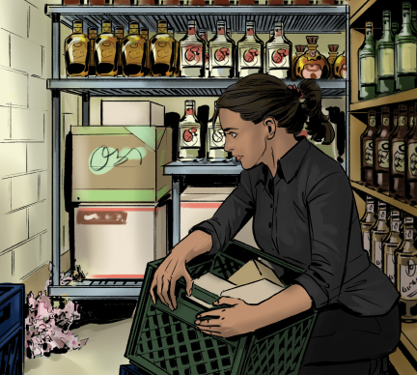
13
Integrated Pest Management

Slide 2
Learning Objectives
After completing this chapter, you should be able to:
Summarize ways to prevent pest risks.
Identify signs of pest infestation and activity.
Describe the criteria for selecting a pest control operator (PCO).
Explain considerations for storing and applying pesticides.

Slide 3
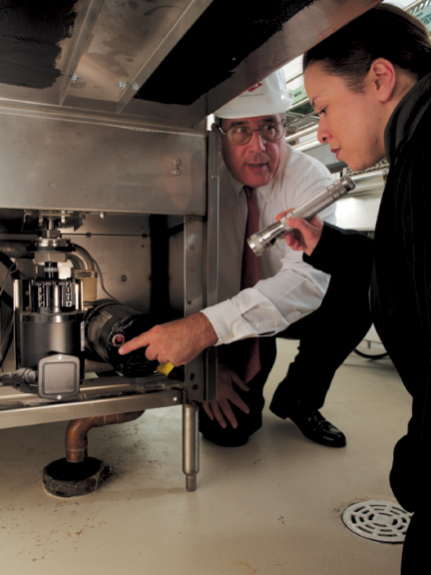
13.1 Integrated Pest Management Programs
Three basic rules of an integrated pest management (IPM) program:
Deny pests access to the operation.
Deny pests food, water, and shelter.
Work with a licensed pest control operator.
Notes:
Instructor Notes
*This slide contains Core Food Safety content.

Slide 4
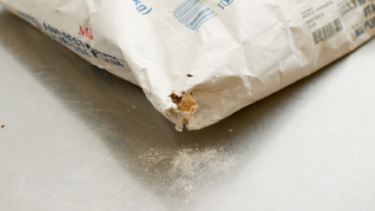
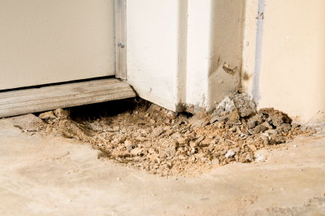
Deny Pests Access
Prevent pests from entering the operation with deliveries.
Screen all windows and vents.
Follow guidelines for doors including:
  Install self-closing devices, door sweeps, and air curtains.
  Keep exterior openings tightly closed.
Notes:
Instructor Notes
*This slide contains Core Food Safety content.

Slide 5
Deny Pests Access Continued
Prevent pests from entering through pipes:
Use concrete to fill holes or sheet metal to cover openings around pipes.
Install screens over ventilation pipes and ducts on the roof.
Cover floor drains with hinged grates.
Seal all cracks in floor and walls and spaces where stationary equipment is fitted to the floor.
Notes:
Instructor Notes
*This slide contains Core Food Safety content.

Slide 6
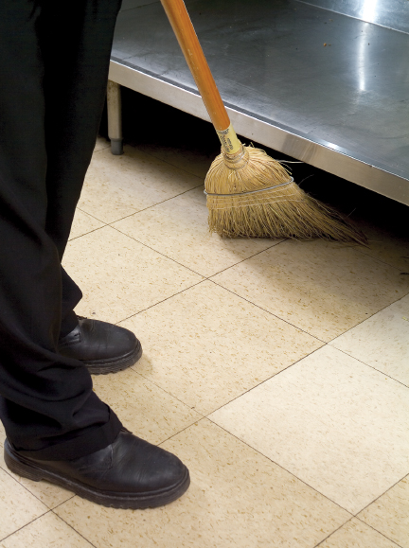
Deny Pests Food and Shelter
Throw out garbage quickly and correctly.
Store recyclables in clean, pest-proof containers.
Store food and supplies correctly.
Clean carefully to eliminate pests’ food supply and reduce places to shelter.
Deny pests’ food and shelter within the operation’s outdoor areas.
Notes:
Instructor Notes
*This slide contains Core Food Safety content.
Knowledge Check
What are the three basic rules to keep an operation pest-free?
How does following a master cleaning schedule help reduce pests?

Slide 7
13.2 Identifying Pests
Flies
Feed on garbage and waste
Cockroaches
Most live and breed in dark, warm, moist, and hard-to-clean places.
Rodents – look for:
Gnawing
Droppings and urine stains
Tracks
Nesting materials
Holes
Notes:
Knowledge Check
What are some signs there could be a roach problem in an operation?
What are some common areas where cockroaches may be found in an operation?

Slide 8
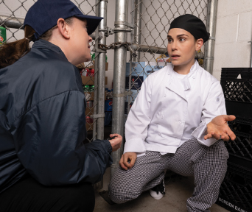
13.3 Working with a Pest Control Operator
How to choose a PCO:
Check references.
Confirm they are licensed.
Require a written service contract.
Notes:
Knowledge Check
What are pesticides?
What are some services a PCO should provide?

Slide 9
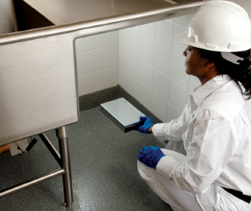
13.4 Treatment
To start effective treatment:
PCO will inspect the facility and grounds.
PCO will provide a written treatment plan.
Control measures should be:
Environmentally sound
Safe for operations
Notes:
Knowledge Check
What is the first step in developing an effective treatment program?
What information should be included in a written treatment plan provided by a PCO?
Activity: Battle of the PCOs

Slide 10
13.5 Using and Storing Pesticides
Rely on your PCO to:
Decide whether to use pesticides.
Apply pesticides.
Additional considerations for using pesticides:
PCO should use pesticides only when the operation is closed and staff is not on-site.
Remove food and cover equipment before area is sprayed.
Notes:
Instructor Notes
*This slide contains Core Food Safety content.

Slide 11
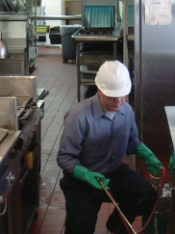
Using and Storing Pesticides
Wash, rinse, and sanitize food-contact surfaces after application.
Have a corresponding Safety Data Sheet (SDS) when pesticides are used or stored.
All pesticides should be stored and disposed of by your PCO.
Notes:
Knowledge Check
Name one reason pesticides should not be applied by restaurant or foodservice staff members.
Prior to the application of pesticide, how should staff protect food-contact surfaces and equipment that cannot be moved?

Slide 12
What are two primary components of an integrated pest management (IPM) program?
How can you prevent pests from entering your operation?
How can you tell if your operation has been infested with rodents?
What are the storage requirements for pesticides?
What precautions must be taken both before and after pesticides are applied in your operation?
Notes:
Answers
What are two primary components of an integrated pest management (IPM) program?
Two primary components of an integrated pest management program are prevention and control. This is done by:
Preventing pests from entering the operation.
Controlling pests by eliminating any that do get inside.
To achieve this, an IPM program has three basic rules to keep your operation pest-free:
Deny pests access to the operation.
Deny pests food, water, and shelter.
Work with a licensed pest control operator.
2. How can you prevent pests from entering your operation?
To prevent pests from entering your operation:
• Use approved, reputable suppliers. Check all deliveries before they enter your operation. Refuse shipments that have pests or signs of pests, such as egg cases and body parts.
• Screen all windows and vents with at least 16 mesh per square inch screening.
• Install self-closing devices and door sweeps on all doors.
• Repair gaps and cracks in door frames and thresholds. Use weather stripping on doors with no thresholds.
• Install air curtains above or alongside doors.
• Keep all exterior openings closed tightly.
• Use concrete to fill holes or sheet metal to cover openings around pipes.
• Install screens over ventilation pipes and ducts on the roof.
• Cover floor drains with hinged grates.
• Seal all cracks in floors and walls.
3. How can you tell if your operation has been infested with rodents?
Signs of a rodent infestation include:
• Signs of gnawing
• Urine stains revealed by black (ultraviolet) light
• Droppings that are shiny and black (fresh) or gray (older)
• Tracks
• Nesting materials, such as scraps of paper, cloth, hair, and other soft materials
• Holes in quiet places, near food and water, and next to buildings
4. What are the storage requirements for pesticides?
All pesticides used in your operation should also be stored by your PCO. If they are stored on the premises, follow these guidelines:
• Keep pesticides in their original containers.
• Store pesticides in a secure location away from where food, utensils, and food equipment are stored.
5. What precautions must be taken both before and after pesticides are applied in your operation?
To minimize the hazard to people, have your PCO use pesticides only when you are closed for business and staff is not on-site. When pesticides will be applied, prepare the area to be sprayed by removing all food and movable food-contact surfaces. Cover equipment and food-contact surfaces that cannot be moved. Wash, rinse, and sanitize food-contact surfaces after the area has been sprayed. Anytime pesticides are used or stored on the premises, you should have corresponding Safety Data Sheets (SDS), because pesticides are hazardous materials.

