Slide 1
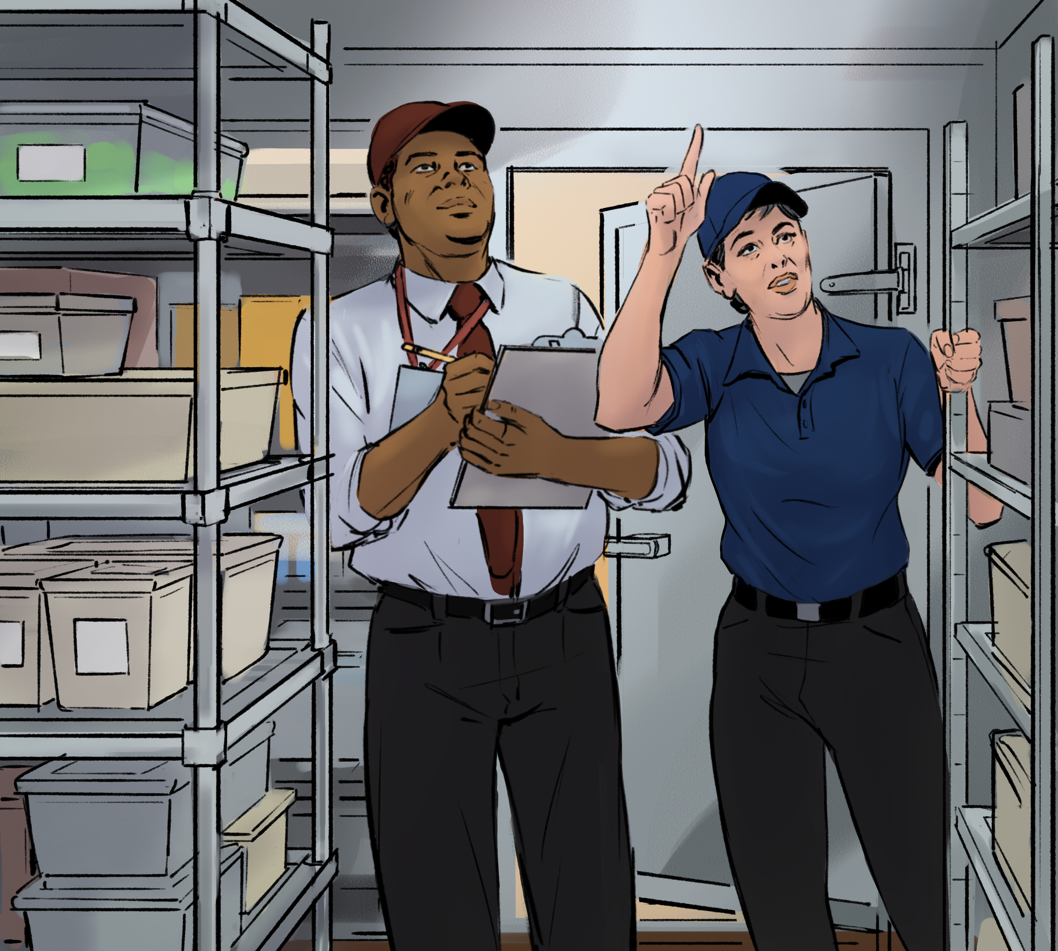
14
Food Safety Regulation and Standards

Slide 2
Learning Objectives
After completing this chapter, you should be able to:
Summarize the roles of federal, state, and local regulatory agencies as related to food safety.
Describe the importance of regulatory inspections and self-inspections.
State the key components of an inspection.
Identify corrective actions to take when found is in violation of a regulation.

Slide 3
14.1 Government Agencies and Foodborne Illness
Several government agencies work to prevent foodborne illness in the United States.
Food and Drug Administration (FDA)
Inspects all food except meat, poultry, and eggs
Regulates food transported across state lines
Issues the FDA Food Code
Notes:
Instructor Notes
*This slide contains Core Food Safety content.

Slide 4
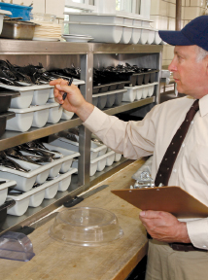
Government Agencies and Foodborne Illness
Other agencies that work to prevent foodborne illness:
U.S. Department of Agriculture (USDA)
Centers for Disease Control and Prevention (CDC)
Public Health Service (PHS)
State and local regulatory authorities
Notes:
Instructor Notes
*This slide contains Core Food Safety content.
Knowledge Check
Are regulatory agencies required to adopt the FDA Food Code?
Who is responsible for inspecting and enforcing food safety regulations for a local business, such as a restaurant or grocery store?

Slide 5
14.2 The Inspection Process
The FDA recommends that regulatory authorities use these risk designations when evaluating operations:
Priority items
Priority foundation items
Core items

Slide 6
Inspection Frequency
Inspections typically occur every six months. Establishments might be inspected more often if they:
are large and offer many TCS foods,
have a history of low sanitation scores or repeated violations, and
serve primarily high-risk populations.
The local regulatory authority’s available resources also impact inspection frequency.

Slide 7

Steps in the Inspection Process
Guidelines for a food safety inspection:
Ask for identification.
Cooperate with the inspector.
Take notes.
Be professional.
Have records ready.

Slide 8

Steps in the Inspection Process Continued
After the inspection:
Study the report.
Discuss violations and timeframes.
Sign and keep copy on file.
Next: Take action to correct deficiencies within the required timeframe.

Slide 9
Closure
Hazards that could lead to an operation’s closure:
Lack of refrigeration
Sewage backup
Emergency, such as a fire or flood
Significant pest infestation
Long interruption of electrical or water service
Clear evidence of a foodborne-illness
Notes:
Knowledge Check
Name at least two of the records that a sanitarian might request during an inspection.
When violations have been noted in an inspection report, how much time does the operation have to correct them?

Slide 10
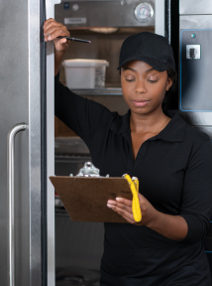
14.3 Self-Inspections and Voluntary Controls
Frequent self-inspections have benefits including safer food and higher inspection scores.
Guidelines:
Use the same type of checklist that the regulatory authority uses.
Identify all risks to food safety.
Meet with staff after to review any issues.
Notes:
Activity: Checking Out the Check List

Slide 11
Self-Inspections and Voluntary Controls
Benefits of self-regulation in the foodservice industry:
Increased understanding of foodborne illness and its prevention
Improvements in the safe design of equipment and facilities
Industry-wide initiatives to maintain safe food during processing, shipment, storage, and service
Efforts to make foodservice laws more practical, uniform, and science-based
Notes:
Knowledge Check
Who is responsible for conducting self-inspections?
What are the benefits of a self-inspection program?

Slide 12
What are some hazards that require the closure of an operation?
What are the roles of federal, state, and local agencies regarding the regulation of food safety in operations?
What should a manager do during and after an inspection?
What are some factors that determine the frequency of health inspections in an operation?
How frequently should self-inspections be conducted?
Notes:
Answers
What are some hazards that require the closure of an operation?
The following hazards require the closure of an operation:
Significant lack of refrigeration
Backup of sewage into the operation or its water supply
Emergency, such as a building fire or flood
Significant infestation of insects or rodents
Long interruption of electrical or water service
Clear evidence of a foodborne-illness outbreak related to the operation
2. What are the roles of federal, state, and local agencies regarding the regulation of food safety in operations?
The FDA and USDA inspect food and regulate food transported across state lines. The FDA also issues the FDA Food Code, which is the government’s recommendations for food safety regulations. The CDC and the PHS assist the FDA and the USDA by conducting research into the causes of foodborne-illness outbreaks. State and local regulatory authorities write or adopt food codes that regulate retail and foodservice operations. These codes differ widely from one state or locality to another. State and local regulatory authorities enforce these food codes.
In addition, they investigate complaints and illnesses, issue licenses and permits, and approve construction.
3. What should a manager do during and after an inspection?
During an inspection, a manager should do the following:
Ask for identification.
Cooperate.
Take notes.
Keep the relationship professional.
Be prepared to provide records requested by the inspector.
After the inspection, the manager should do the following:
Discuss violations and time frames for correction with the inspector.
Act on all deficiencies noted in the report by determining why each problem occurred, and then establish new procedures or revise existing ones. It may also be necessary to retrain staff.
4. What are some factors that determine the frequency of health inspections in an operation?
Factors that determine the frequency of a health inspection include:
Size and complexity of the operation. Larger operations offering a large number of TCS food items might be inspected more frequently.
Inspection history of the operation. Operations with a history of low sanitation scores or consecutive violations might be inspected more frequently.
Clientele’s susceptibility to foodborne illness. Nursing homes, schools, daycare centers, and hospitals might receive more frequent inspections.
Workload of the local health department and the number of inspectors available.
5. How frequently should self-inspections be conducted?
Well-managed operations perform frequent self-inspections to keep food safe. These are done in addition to—and more often than—regulatory inspections.

