Slide 1

15
Staff Food Safety Training

Slide 2
Learning Objectives
After completing this chapter, you should be able to:
Discuss the importance of initial and ongoing food safety training
List critical food safety knowledge needed by food handlers
Explain the requirement to maintain food safety training records
Discuss the importance of monitoring staff members after training them in food safety
Identify the need to retrain staff in food safety
Summarize different ways to train staff when teaching food safety

Slide 3
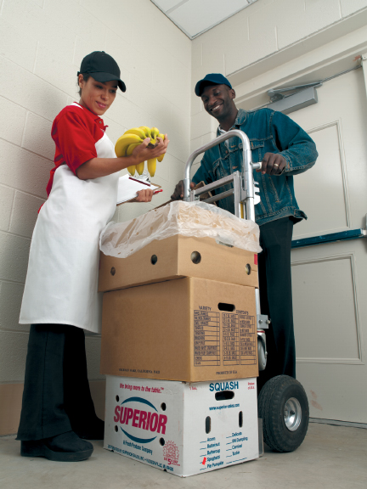
15.1 Training Staff
Training staff when they are first hired and then on an ongoing basis.
Identify staff food safety training needs by:
Observing on the job performance
Testing food safety knowledge
Notes:
Instructor Notes
*This slide contains Core Food Safety content.

Slide 4
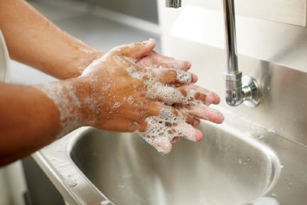

Critical Food Safety Knowledge
All staff should receive training on:
Good personal hygiene
Controlling time and temperature
Preventing cross-contamination
Cleaning and sanitizing

Slide 5
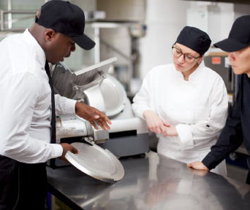
Training Staff Continued
Retraining
Regularly retrain staff in food safety to prevent the “forgetting curve.”
Record keeping
Document when a staff member completes any food safety training and keep records at the operation.
Notes:
Knowledge Check
Why must staff members be monitored after they are trained?
What is the “forgetting curve” and what can trainers do to fight it?

Slide 6
15.2 Ways of Training
On the Job Training
Learners perform tasks while trainers give feedback.
Good for training individuals or small groups.
Success depends on the trainer.
Classroom Training
Include activities.
Encourage questions.
Promote learning by doing and allow learners to make mistakes.

Slide 7
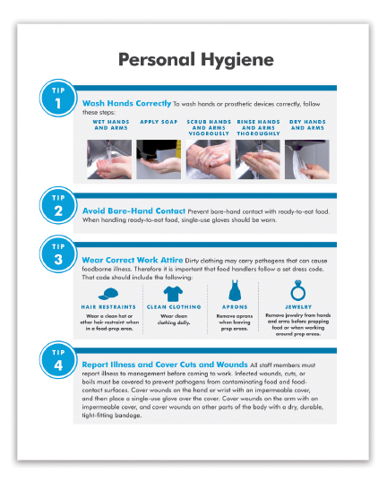
Classroom Activities
Information Search
Give learners tools that allow them to discover food safety information for themselves.
Guided Discussion
Ask staff questions that draw on their knowledge and experiences.
Follow up with another question each time a learner answers.

Slide 8
Classroom Activities Continued
Games
Can make boring or difficult information exciting
Role play
Can be effective for learning how to handle situations like guests with food allergies or a health inspection
Demonstrations
Tell
Show
Do
Jigsaw Design
Small group activity that allows learners to learn and teach their peers

Slide 9
Training Videos
Videos can be effective if they follow these guidelines:
Focus on key areas.
Play in short segments.
Target learning goals.
Provide guiding questions.
Pause at specific points.
Reinforce video content.

Slide 10

Technology-based Training
Most appropriate in these situations:
Staff work in different locations, and it is too costly to bring them to the same place.
Staff need retraining.
Staff have different levels of knowledge or need to learn at their own pace.
Training data is needed.
Notes:
Knowledge Check
What can instructors do to ensure that videos promote learning?
What is the difference between synchronous and asynchronous elearning?
Activity: Train and Review

Slide 11
How can an operation determine its food safety training needs?
What are some methods that can be used to deliver food safety training?
Notes:
Answers
How can an operation determine its food safety training needs?
An operation can determine its food safety training needs by doing the following:
Testing staff members’ food safety knowledge
Observing staff job performance
Questioning or surveying staff members to identify areas of weakness
2. What are some methods that can be used to deliver food safety training?
Methods of delivering food safety training include:
On-the-job training
Classroom training
Information search
Guided discussion
Games
Role-play
Demonstrations
Jigsaw design
Training videos and DVDs
Technology-based training

