Slide 1
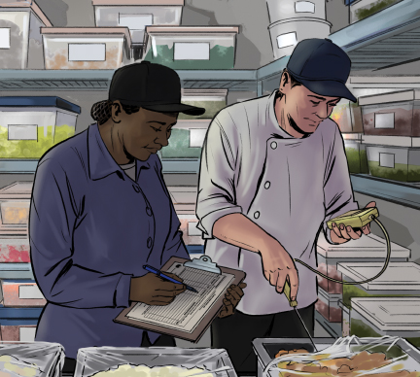
10
Food Safety Management Systems

Slide 2
Learning Objectives
After completing this chapter, you should be able to:
Explain what a food safety management system is and list the food safety programs that must be in place for it to be effective.
Define active managerial control, identify how it can be achieved, and list the steps for implementing it.
Summarize the FDA’s public health interventions for controlling the common risk factors for foodborne illness.

Slide 3
Learning Objectives Continued
Identify the basis for an effective HACCP system and summarize the seven HACCP principles.
Describe how to prepare for, respond to, and recover from a crisis.
Summarize the process for responding to a foodborne-illness outbreak.
Define imminent health hazards, list examples, and describe the proper response to them.

Slide 4
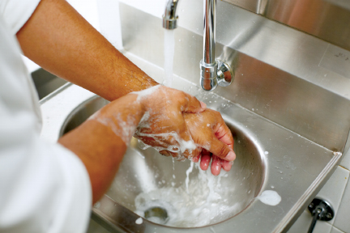
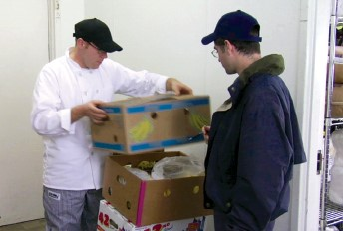
10.1 Food Safety Management Systems
A food safety management system is a group of practices and procedures intended to prevent foodborne illness.
These programs include:
Personal hygiene
Supplier selection and specification
Cleaning and sanitizing
Pest control
Notes:
Instructor Notes
*This slide contains Core Food Safety content.
Knowledge Check
1. What is a food safety management system?
2. List at least three of the programs that must be in place to establish a food safety management system.

Slide 5

10.2 Active Managerial Control
Steps to implement:
Identify Risks.
Monitor critical activities.
Take corrective action.
Oversee policies and procedures.
Train and re-train employees.
Re-evaluate the system periodically.
Notes:
Instructor Notes
*This slide contains Core Food Safety content.

Slide 6
The FDA’s Public Health Interventions
The FDA Food Code provides five specific recommendations for controlling the common risk factors for foodborne illness.
Demonstration of knowledge
Staff health controls
Controlling hands as a vehicle of contamination
Time and temperature parameters for controlling pathogens
Consumer advisories
Notes:
Instructor Notes
*This slide contains Core Food Safety content.

Slide 7

The Seven HACCP Principles
A HACCP system is designed to identify and reduce hazards within the flow of food.
Follow these principles:
Conduct a hazard analysis.
Determine critical control points.
Notes:
Instructor Notes
*This slide contains Core Food Safety content.
HACCP is pronounced HASS-ip.

Slide 8
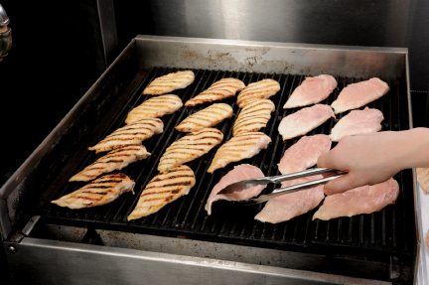
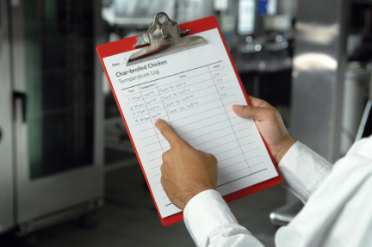
The Seven HACCP Principles Continued
Establish critical limits.
Establish monitoring procedures.
Identify corrective actions.
Verify the system works.
Establish procedures for record keeping and documentation.
Notes:
Knowledge Check
List the steps for implementing active managerial control in an establishment.
Summarize the seven HACCP principles.
Activity: Plan for a Plan

Slide 9
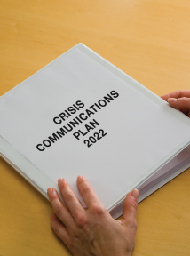
10.3 Crisis Management
First: Create a crisis management team.
Next: Prepare for a crisis.
Create an emergency contact list.
Develop a crisis-communication plan.
Assemble a crisis kit.
Prepare for a foodborne-illness outbreak.

Slide 10
Crisis Response Guidelines
Manage a crisis effectively by:
Working with the media
Communicating information directly to your key audiences
Finding a solution and communicating it
Responding quickly in the event of a foodborne illness outbreak

Slide 11

Crisis Recovery and Assessment
To respond to a foodborne illness outbreak:
Work with the regulatory authority.
Clean and sanitize all areas.
Throw out suspected food.
Review food handling procedures.
Develop a plan to reassure customers.
Notes:
Instructor Notes
*This slide contains Core Food Safety content.

Slide 12
Imminent Health Hazards
An imminent health hazard is a significant threat or danger to health that requires immediate correction or closure to prevent injury.
How to respond:
Stop service.
Notify regulatory authority.
Throw out spoiled or contaminated food.
Notes:
Instructor Notes
*This slide contains Core Food Safety content.

Slide 13
Water Service Interruption
Create a plan in case of a water service interruption.
Keep a supply of single-use items and bottled water.
Have a supplier who can provide ice in an emergency.
Develop emergency handwashing procedures.
Take action after water is restored.

Slide 14
Power Outage
Create a plan in case of a power outage.
Arrange access to an electrical generator and a refrigerated truck.
Prepare a menu with items that do not require cooking.
Develop a policy for when cooler doors should be opened.

Slide 15
Fires and Floods
Fire
Have emergency contact information.
Post fire department phone number by all phones.
Flood
Have a plan to monitor and maintain flood control equipment.
Have emergency contact information.
Keep a supply of bottled water.
Notes:
Knowledge Check
Summarize the process for responding to foodborne-illness complaints.
Define imminent health hazard and list examples.

Slide 16
What types of food safety programs must be in place as a foundation for a food safety management system?
What are some ways to achieve active managerial control?
Summarize the activities involved in the first HACCP principle “Conduct a Hazard Analysis.”
Under what conditions might a regulatory authority allow an operation to continue operating in the event of a water or electrical interruption?
Notes:
Answers
What types of food safety programs must be in place as a foundation for a food safety management system?
The following programs are a foundation for a food safety management system:
Personal hygiene program
Food safety training program
Supplier selection and specification program
Quality control and assurance program
Cleaning and sanitation program
Standard operating procedures (SOPs)
Facility design and equipment maintenance program
Pest control program
2. What are some ways to achieve active managerial control?
There are many ways to achieve active managerial control in the operation. According to the Food and Drug Administration (FDA), you can use simple tools such as training programs, manager supervision, and the incorporation of SOPs. Active managerial control can also be achieved through more complex solutions, such as a HACCP program. Monitoring is critical to the success of active managerial control. Food will be safe if managers monitor critical activities in the operation. Managers must take the necessary corrective action when required. They must also verify that the actions taken to control the risk factors for foodborne illness are actually working.
3. Summarize the activities involved in the first HACCP principle “Conduct a Hazard Analysis.”
The first HACCP principle is “Conduct a Hazard Analysis,” in which you must identify and assess potential hazards in the food you serve. Start by looking at how food is processed in your operation. Many types of food are processed in similar ways. Here are some common processes:
Prepping and serving without cooking (salads, cold sandwiches, etc.)
Prepping and cooking for same-day service (grilled chicken sandwiches, hamburgers, etc.)
Prepping, cooking, holding, cooling, reheating, and serving (chili, soup, pasta sauce with meat, etc.)
Look at your menu and identify items that are processed like this. Next, identify the TCS food. Determine where food safety hazards are likely to occur for each TCS food. They can come from biological, chemical, or physical contaminants.
4. Under what conditions might a regulatory authority allow an operation to continue operating in the event of a water or electrical interruption?
The regulatory authority may allow an operation to continue operating in the event of a water or electrical interruption under the following conditions:
The operation has a written emergency operating plan approved in advance by the regulatory authority.
An immediate corrective action is taken to prevent, eliminate, or control any food safety risk and imminent health hazard associated with the interruption.
The regulatory authority is informed upon implementing the emergency operating plan.

