Slide 1
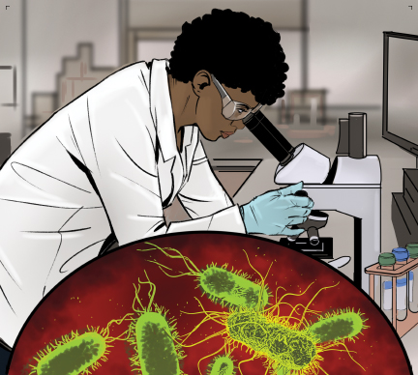
2
Understanding the Microworld

Slide 2
Learning Objectives
After completing this chapter, students should be able to:
Identify the conditions that affect the growth of food-borne bacteria (FAT TOM).
Describe the characteristics of major foodborne pathogens, their sources, resulting illnesses, and symptoms.
Describe ways to prevent viral, bacterial, parasitic, and fungal contamination.
Characterize naturally occurring toxins and ways to prevent illnesses caused by them.

Slide 3
2.1 Pathogens
Biological contamination, a serious risk to food safety, occurs from microorganisms.
Microorganism
Small, living organism that can be seen only with a microscope
Pathogen
Harmful microorganism
Makes people sick when eaten or produces toxins that cause illness
Toxin
Poison
Notes:
Instructor Notes
*This slide contains Core Food Safety content.

Slide 4
How Contamination Happens
Ways that food handlers can contaminate food include:
Not washing hands after using the restroom
Sneezing or vomiting onto food or food-contact surfaces
Allowing ready-to-eat food to touch a surface that contacted raw meat, seafood, or poultry
Storing food or cleaning products incorrectly
Failing to spot signs of pests
Notes:
Instructor Notes
*This slide contains Core Food Safety content.
Most pathogens get into food and onto food-contact surfaces because of the way that people handle them.

Slide 5

Symptoms of a Foodborne Illness
Common symptoms of foodborne illness:
Diarrhea
Vomiting
Fever
Nausea
Abdominal cramps
Jaundice
Notes:
Instructor Notes
*This slide contains Core Food Safety content.
Onset time can range from 30 minutes to six weeks, depending on the type of foodborne illness. The person in the picturing has yellowing skin and eyes, indicating jaundice.

Slide 6
The “Big Six” Pathogens
The FDA identified these pathogens as highly infectious and capable of causing severe illness:
  Salmonella Typhi
  Shigella spp.
  Nontyphoidal Salmonella (NTS)
  Shiga toxin-producing Escherichia coli (STEC), also known as E.coli
  Hepatitis A
  Norovirus
Notes:
Instructor Notes
*This slide contains Core Food Safety content.
Knowledge Check
What are some of the ways that pathogens can be transmitted?
How can incorrect handwashing cause foodborne illness?

Slide 7
2.2 Bacteria
Characteristics of bacteria:
Found almost everywhere
Cannot be seen, smelled, or tasted
Grow rapidly if conditions are correct
Can produce toxins as they grow and die
Need six conditions to grow FAT TOM
Notes:
Instructor Notes
*This slide contains Core Food Safety content.

Slide 8
What Bacteria Need to Grow: Food and Acid
FAT TOM
Food
TCS food best supports the growth of bacteria better than other foods.
Acidity
Bacteria grow best in food that contains little or no acid.
pH of 7.5 to 4.6 is ideal
Notes:
Instructor Notes
*This slide contains Core Food Safety content.

Slide 9
What Bacteria Need to Grow: Temperature and Time
FAT TOM
Temperature
Bacteria grow rapidly in the temperature danger zone between 41°F and 135°F (5°C and 57°C).
Bacteria grow even more rapidly from 70˚F to 125˚F (21˚C to 52˚C).
Time
The longer bacteria spend in the temperature danger zone, the more time they have to grow to unsafe levels.
Notes:
Instructor Notes
*This slide contains Core Food Safety content.

Slide 10
What Bacteria Need to Grow: Oxygen and Moisture
FAT TOM
Oxygen
Some bacteria need oxygen to grow while others grow when oxygen is not there.
Moisture
Bacteria grow well in food with high levels of moisture.
Notes:
Instructor Notes
*This slide contains Core Food Safety content.

Slide 11
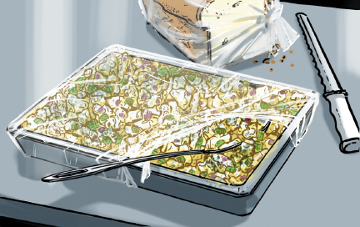
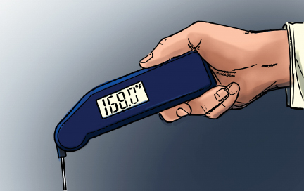
Controlling FAT TOM Conditions
In an operation, you usually have control over these two conditions:
Time: Limit how long TCS food spends in the temperature danger zone.
Temperature: Keep TCS food out of the temperature danger zone.
Notes:
Instructor Notes
*This slide contains Core Food Safety content.

Slide 12
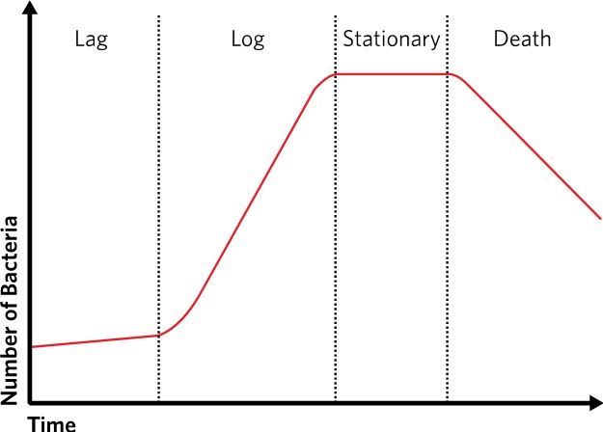
Bacterial Growth
Stages of Growth
Lag
Log
Stationary
Death
Notes:
Instructor Notes
To keep from dying when they lack nutrients, certain bacteria can change into a form called a spore.

Slide 13
Major Foodborne Bacteria #1
Bacteria: Shiga toxin-producing Escherichia coli, also known as E. coli, including: O157:H7, O26:H11, O111:H8, and O158:NM
Illness: Hemorrhagic colitis
Commonly Linked Foods
Ground beef (raw and undercooked)
Contaminated produce
Most Common Symptoms
Diarrhea (becomes bloody)
Abdominal cramps
Kidney failure (in severe cases)
Notes:
Instructor Notes
*This slide includes Core Food Safety content.
The bacteria is pronounced: ess-chur-EE-kee-UH KO-LI. The illness is pronounced: hem-or-RA-jik ko-LI-tiss. It is a “Big Six” pathogen.

Slide 14
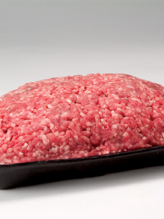
Major Foodborne Bacteria #1 Continued
Bacteria: Shiga toxin-producing Escherichia coli, also known as E. coli, including: O157:H7, O26:H11, O111:H8, and O158:NM
Prevention Measures
  Control time and temperature.
  Cook food, especially ground beef, to minimum internal temperatures.
  Purchase produce from approved, reputable suppliers.
  Prevent cross-contamination.
Notes:
Instructor Notes
*This slide contains Core Safety Content

Slide 15
Major Foodborne Bacteria #2
Bacteria: Nontyphoidal Salmonella
Illness: Salmonellosis
Commonly Linked Foods
Poultry and eggs
Dairy products
Produce such as tomatoes, peppers, and cantaloupes
Most Common Symptoms
Diarrhea
Abdominal cramps
Vomiting
Fever
Notes:
Instructor Notes
*This slide contains Core Food Safety content.
The bacteria is pronounced: SAL-me-NEL-uh. The illness is pronounced: SAL-men-uh-LO-sis. It is a “Big Six” pathogen.

Slide 16
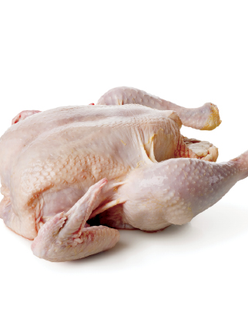
Major Foodborne Bacteria #2 Continued
Bacteria: Nontyphoidal Salmonella
Prevention Measures
  Prevent cross-contamination.
  Cook poultry and eggs to minimum internal temperatures.
  Exclude food handlers who are vomiting or have diarrhea and have been diagnosed with an illness caused by nontyphoidal Salmonella.
Notes:
Instructor Notes
*This slide contains Core Food Safety content.

Slide 17
Major Foodborne Bacteria #3
Bacteria: Salmonella Typhi
Illness: Typhoid Fever
Commonly Linked Foods
Ready-to-eat food
Beverages
Most Common Symptoms
High fever
Weakness
Abdominal pain
Headaches
Loss of appetite
Rash
Notes:
Instructor Notes
*This slide contains Core Food Safety content.
The bacteria is pronounced: SAL-me-NEL-uh Ti-fee. It is a “Big Six” pathogen.

Slide 18
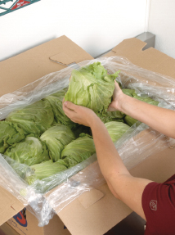
Major Foodborne Bacteria #3 Continued
Bacteria: Salmonella Typhi
Prevention Measures
  Prevent cross-contamination.
  Cook food to minimum internal temperatures.
  Wash hands.
  Exclude food handlers who are vomiting or have diarrhea and have been diagnosed with an illness caused by Salmonella Typhi.
Notes:
Instructor Notes
*This slide contains Core Food Safety content.

Slide 19
Major Foodborne Bacteria #4
Bacteria: Shigella spp.
Illness: Shigellosis
Commonly Linked Foods
Salads containing TCS food (ex: potato, tuna, shrimp)
Food in contact with contaminated water (ex: produce)
Most Common Symptoms
Bloody diarrhea
Abdominal pain and cramps
Fever (occasionally)
Notes:
Instructor Notes
*This slide contains Core Food Safety content.
The bacteria is pronounced: shi-GEL-uh. The illness is pronounced: SHIG-uh-LO-sis. It is a “Big Six” pathogen.

Slide 20
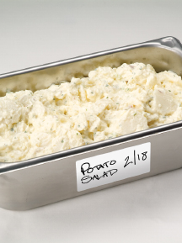
Major Foodborne Bacteria #4 Continued
Bacteria: Shigella spp.
Prevention Measures
  Practice good personal hygiene.
  Wash hands.
  Exclude food handlers who have diarrhea and have been diagnosed with an illness caused by Shigella spp.
  Control flies inside and outside the operation.
Notes:
Instructor Notes
*This slide contains Core Food Safety content.
Knowledge Check
What is the range in the temperature danger zone within which bacteria grow most rapidly?
Which bacteria are included in the “Big Six”?

Slide 21
2.3 General Information about Viruses
Location
Carried by human beings and animals
Require a living host
Sources
Food, water, or any contaminated surface
Transfer
Viruses can be transferred from person to person, person to food, and person to food-contact surfaces.
Typically occur through fecal-oral routes
Notes:
Instructor Notes
*This slide contains Core Food Safety content.

Slide 22
General Information about Viruses
Some viruses cannot be destroyed by normal cooking temperatures.
Prevention measures:
Exclude food handlers who are vomiting or have diarrhea or jaundice from working.
Make sure food handlers wash their hands regularly and correctly.
Avoid bare-hand contact with ready-to-eat food.
The quick removal and cleanup of vomit is also important.
Notes:
Instructor Notes
*This slide contains Core Food Safety content.

Slide 23
Major Foodborne Viruses #1
Virus: Hepatitis A
Illness: Hepatitis A
Commonly Linked Foods
Ready-to-eat food
Shellfish from contaminated water
Most Common Symptoms
Fever (mild)
General Weakness
Nausea
Abdominal pain
Jaundice (appears later)
Notes:
Instructor Notes
*This slide contains Core Food Safety content.
Hepatitis A is a “Big Six” pathogen.

Slide 24
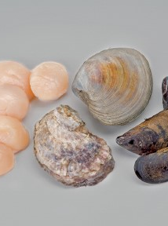
Major Foodborne Viruses #1 Continued
Virus: Hepatitis A
Prevention Measures
  Practice good personal hygiene.
  Exclude food handlers who have been diagnosed with hepatitis A or who have had jaundice for seven days.
  Avoid bare-hand contact with ready-to-eat food.
  Purchase shellfish from approved, reputable suppliers.
Notes:
Instructor Notes
*This slide contains Core Food Safety content.

Slide 25
Major Foodborne Viruses #2
Virus: Norovirus
Illness: Norovirus gastroenteritis
Commonly Linked Foods
Ready-to-eat food
Shellfish from contaminated water
Most Common Symptoms
Vomiting
Diarrhea
Nausea
Abdominal cramps
Notes:
Instructor Notes
*This slide contains Core Food Safety content.
Norovirus is a “Big Six” pathogen.

Slide 26
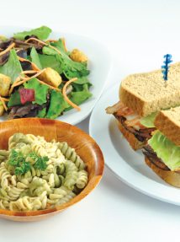
Major Foodborne Viruses #2 Continued
Virus: Norovirus
Prevention Measures
  Practice good personal hygiene.
  Exclude food handlers who are vomiting or have diarrhea and have been diagnosed with Norovirus from the operation.
  Avoid bare-hand contact with ready-to-eat food.
  Purchase shellfish from approved, reputable suppliers.
Notes:
Instructor Notes
*This slide contains Core Food Safety content.
Activity: Mapping Pathogens
Knowledge Check
What are the best ways to prevent the spread of viruses in a restaurant or foodservice operation?
Are all viruses destroyed by normal cooking temperatures?

Slide 27
2.4 General Information about Parasites
Location
Require a host to live and reproduce
Sources
Seafood, wild game, and food processed with contaminated water, such as produce
Prevention
Purchase food from approved, reputable suppliers.
Cook food to required minimum internal temperatures.
Fish that will be served raw or undercooked must be frozen correctly by the manufacturer.
Notes:
Instructor Notes
*This slide includes Core Food Safety content.
Knowledge Check
Can parasites grow in food, such as steak?
What are the most common measures to prevent infection by parasites in a restaurant or foodservice operation?

Slide 28
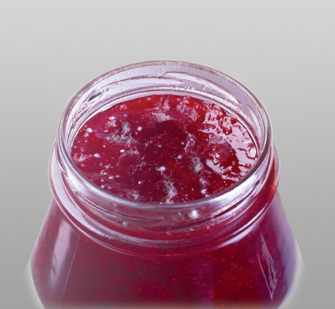
2.5 General Information about Fungi
Fungi are pathogens that spoil food and sometimes make people sick.
Throw away food showing signs of:
  Mold
  Yeast
Notes:
Instructor Notes
*This slide contains Core Food Safety content.
Knowledge Check
1. Can fungi make people sick when consumed?
2. Which type of toxin is created by some molds?

Slide 29
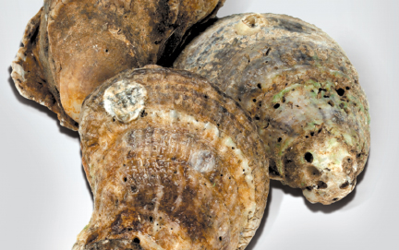
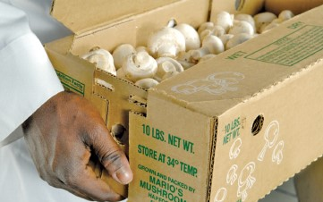
2.6 Biological Toxins
Sources of biological toxins:
Seafood
Plants
Mushrooms
Prevention Measures
Purchase from approved, reputable suppliers
Notes:
Instructor Notes
*This slide contains Core Food Safety content.
Knowledge Check
1. Which seafood toxin can be prevented through proper holding?
2. Can mushroom toxins be destroyed by thorough freezing?

Slide 30
Discussion Questions
What are the six conditions that support the growth of bacteria?
What two FAT TOM conditions are easiest for an operation to control?
How can an outbreak of Norovirus be prevented?
What measures should be taken to prevent a seafood-specific foodborne illness?
What six pathogens have been dubbed the “Big Six”? Why have they been singled out by the FDA?
Notes:
Answers
1. What are the six conditions that support the growth of bacteria?
Food: Carbohydrates or proteins
Acidity: Food that contains little or no acid
Temperature: Temperatures between 41°F and 135°F (5°C and 57°C)
Time: The longer food spends at temperatures between 41°F and 135°F (5°C and 57°C), the more opportunity bacteria in the food have to grow to unsafe levels
Oxygen: Some bacteria grow with oxygen, others grow without it
Moisture: Food with high levels of available moisture
2. What two FAT TOM conditions are easiest for an operation to control?
Time and temperature. To control time, limit how long TCS food spends in the temperature danger zone. To control temperature, keep TCS food out of the temperature danger zone.
3. How can an outbreak of Norovirus be prevented?
An outbreak of Norovirus can be prevented by practicing good personal hygiene. This is the most important prevention measure and includes the following:
Excluding staff members with diarrhea and vomiting from the operation
Excluding staff members who have been diagnosed with Norovirus from the operation
Washing hands
Avoiding bare hand contact with ready-to-eat food
4. What measures should be taken to prevent a seafood-specific foodborne illness?
*Food must be purchased from an approved, reputable supplier. This is the single most important prevention measure.
5. What six pathogens have been dubbed the “Big Six”? Why have they been singled out by the FDA?
The “Big Six” pathogens include the bacteria Shigella spp., Salmonella Typhi, Nontyphoidal Salmonella, and Shiga toxin-producing E. coli, and the viruses hepatitis A and Norovirus. These pathogens have been singled out by the FDA because they are highly infectious.

