Slide 1
1
Keeping Food Safe

Slide 2
Learning Objectives
After completing this chapter, you should be able to:
Explain what a foodborne illness is and how to determine when one has occurred.
Summarize the challenges to food safety and the five common risk factors that can cause foodborne illness.
Identify types of contaminants and state the methods of prevention.
Define TCS food and ready-to-eat food.
Identify high-risk populations.
Summarize the food safety responsibilities of the person in charge of a foodservice operation.
Notes:
Instructor Notes
Please review the Coursebook Instructor Change Document for important information on 2022 FDA Food Code changes related to this chapter. More information can be found at www.ServSafe.com/Academic

Slide 3
1.1 Foodborne Illnesses
A foodborne illness is a disease transmitted to people through food.
An illness is considered an outbreak when:
Two or more people have the same symptoms after eating the same food.
An investigation is conducted by state and local regulatory authorities.
The outbreak is confirmed by laboratory analysis.
Notes:
Instructor Notes
*This slide contains Core Food Safety content.

Slide 4
Challenges to Food Safety
Time
Language and culture
Literacy and education
Pathogens
Unapproved suppliers
High-risk populations
Staff turnover
Notes:
Instructor Notes
*This slide contains Core Food Safety content.

Slide 5
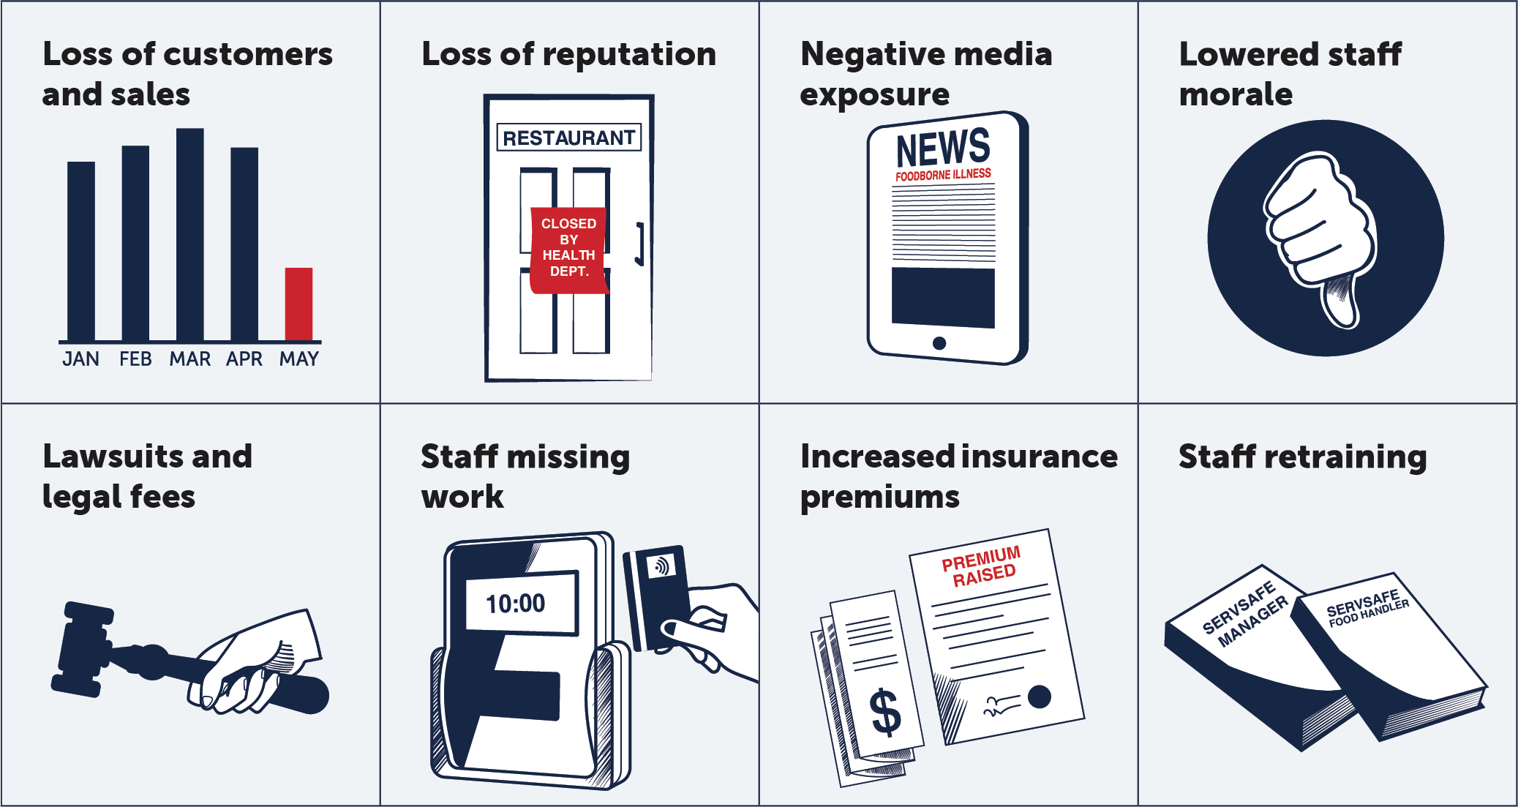
The Costs of Foodborne Illnesses
Notes:
Instructor Notes
*This slide contains Core Food Safety content.
Knowledge Check
1. What are some of the common challenges to food safety in a restaurant or foodservice operation?
2. What is the definition of a foodborne illness?

Slide 6
1.2 How Foodborne Illnesses Occur
Unsafe food is the result of contamination, which is the presence of harmful substances in food.
Three categories:
Biological
Chemical
Physical
Notes:
Instructor Notes
*This slide contains Core Food Safety content.

Slide 7
How Food Becomes Unsafe
Five risk factors for foodborne illness:
Purchasing food from unsafe sources
Failing to cook food correctly
Holding food at incorrect temperatures
Using contaminated equipment
Practicing poor personal hygiene
Notes:
Instructor Notes
*This slide contains Core Food Safety content.
Purchasing food from unsafe sources will be addressed in a later chapter.

Slide 8
How Food Becomes Unsafe: Time-Temperature Abuse
Time-temperature abuse: When food stays too long at temperatures good for pathogen growth
Food has been time-temperature abused when
It has not been held at correct temperatures.
It is not cooked or reheated enough to kill pathogens.
It is not cooled correctly.
Notes:
Instructor Notes
*This slide contains Core Food Safety content.

Slide 9
How Food Becomes Unsafe: Cross-Contamination
Cross-contamination: When pathogens are transferred from one surface or food to another.
This can happen when
Contaminated ingredients are added to food that receives no further cooking.
Ready-to-eat food touches contaminated surfaces.
A food handler touches contaminated food and then touches ready-to-eat food.
Notes:
Instructor Notes
*This slide contains Core Food Safety content.

Slide 10
How Food Becomes Unsafe: Personal Hygiene
Poor personal hygiene can cause a foodborne illness when food handlers:
Fail to wash their hands correctly after using the restroom
Cough or sneeze on food
Touch wounds and then touch food
Work while sick
Notes:
Instructor Notes
*This slide contains Core Food Safety content.

Slide 11
How Food Becomes Unsafe: Poor Cleaning and Sanitizing
Poor cleaning and sanitizing can cause a foodborne illness when:
Equipment and utensils are not washed, rinsed, and sanitized between uses.
Food-contact surfaces are wiped clean instead of being washed, rinsed, and sanitized.
Wiping cloths are not stored in a sanitizer solution between uses.

Slide 12
Foods Most Likely to Become Unsafe
TCS food is food that requires time and temperature control to limit pathogen growth
“time and temperature control for safety”
Ready-to-eat food is food that can be eaten without further preparation, washing, or cooking.

Slide 13
Populations at High Risk for Foodborne Illnesses
These people have a higher risk of getting a foodborne illness:
Preschool-age children
Elderly people
People with compromised immune systems
Notes:
Instructor Notes
*This slide contains Core Food Safety content.
Activity: Imagining Risks
Knowledge Check
What are the five most common risk factors for food safety?
List at least six TCS foods.

Slide 14
1.3 Keeping Food Safe
The person in charge of an operation must:
Be a Certified Food Protection Manager
Be onsite during operating hours
A Certified Food Protection Manager must show they have the required knowledge by passing a test from an accredited program.

Slide 15
Food Safety Responsibilities of a Manager
According to the FDA, a food safety manager should ensure that an operation meets standards that include
Monitoring staff handwashing
Ensuring TCS food is cooked to required temperatures
Inspecting deliveries
Training staff on food safety
Notifying guests

Slide 16
Marketing Food Safety
Offer training. Evaluate and update it as needed.
Discuss food safety expectations.
Document and maintain food-handling procedures.
Consider awards and rewards for good food safety records.
Set a good example.
Notes:
Knowledge Check
Which factors determine whether a certified food protection manager must be onsite at all times?
Name at least five food safety standards that the person in charge must ensure in the operation.

Slide 17
Discussion Questions
What are the potential costs associated with foodborne-illness outbreaks?
Why are the elderly at a higher risk for getting foodborne illnesses?
What are the three major types of contaminants?
What are some common ways that time-temperature abuse can happen?
Notes:
Answers
1. What are the potential costs associated with foodborne-illness outbreaks?
*Loss of guests and sales
*Loss of reputation
*Negative media exposure
*Lawsuits and legal fees
*Increased insurance premiums
*Lowered staff morale
*Staff absenteeism
*Staff retraining
*Closure of the operation
*Human costs, such as lost work, medical costs, long-term disability, and death
2. Why are the elderly at a higher risk for getting foodborne illnesses?
As people age, there are changes in their organs. For example, stomach-acid production decreases as people get older. This allows more pathogens to enter the intestines. A change in the stomach and intestinal tract also allows the body to store food for longer periods. This gives toxins more time to form.
3. What are the three major types of contaminants? The three major types of contaminants are biological, chemical, and physical. Biological contaminants include bacteria, viruses, parasites, and fungi. Chemical contaminants include foodservice chemicals such as cleaners, sanitizers, and polishes. Physical hazards include foreign objects such as metal shavings, staples, bandages, glass, and dirt. Naturally occurring objects, such as fish bones in fillets, are another example.
4. What are some common ways that time-temperature abuse can happen?
Food is not held or stored at correct temperatures,
Food is not cooked or reheated enough to kill pathogens.
Food is not cooled correctly.

