Slide 1
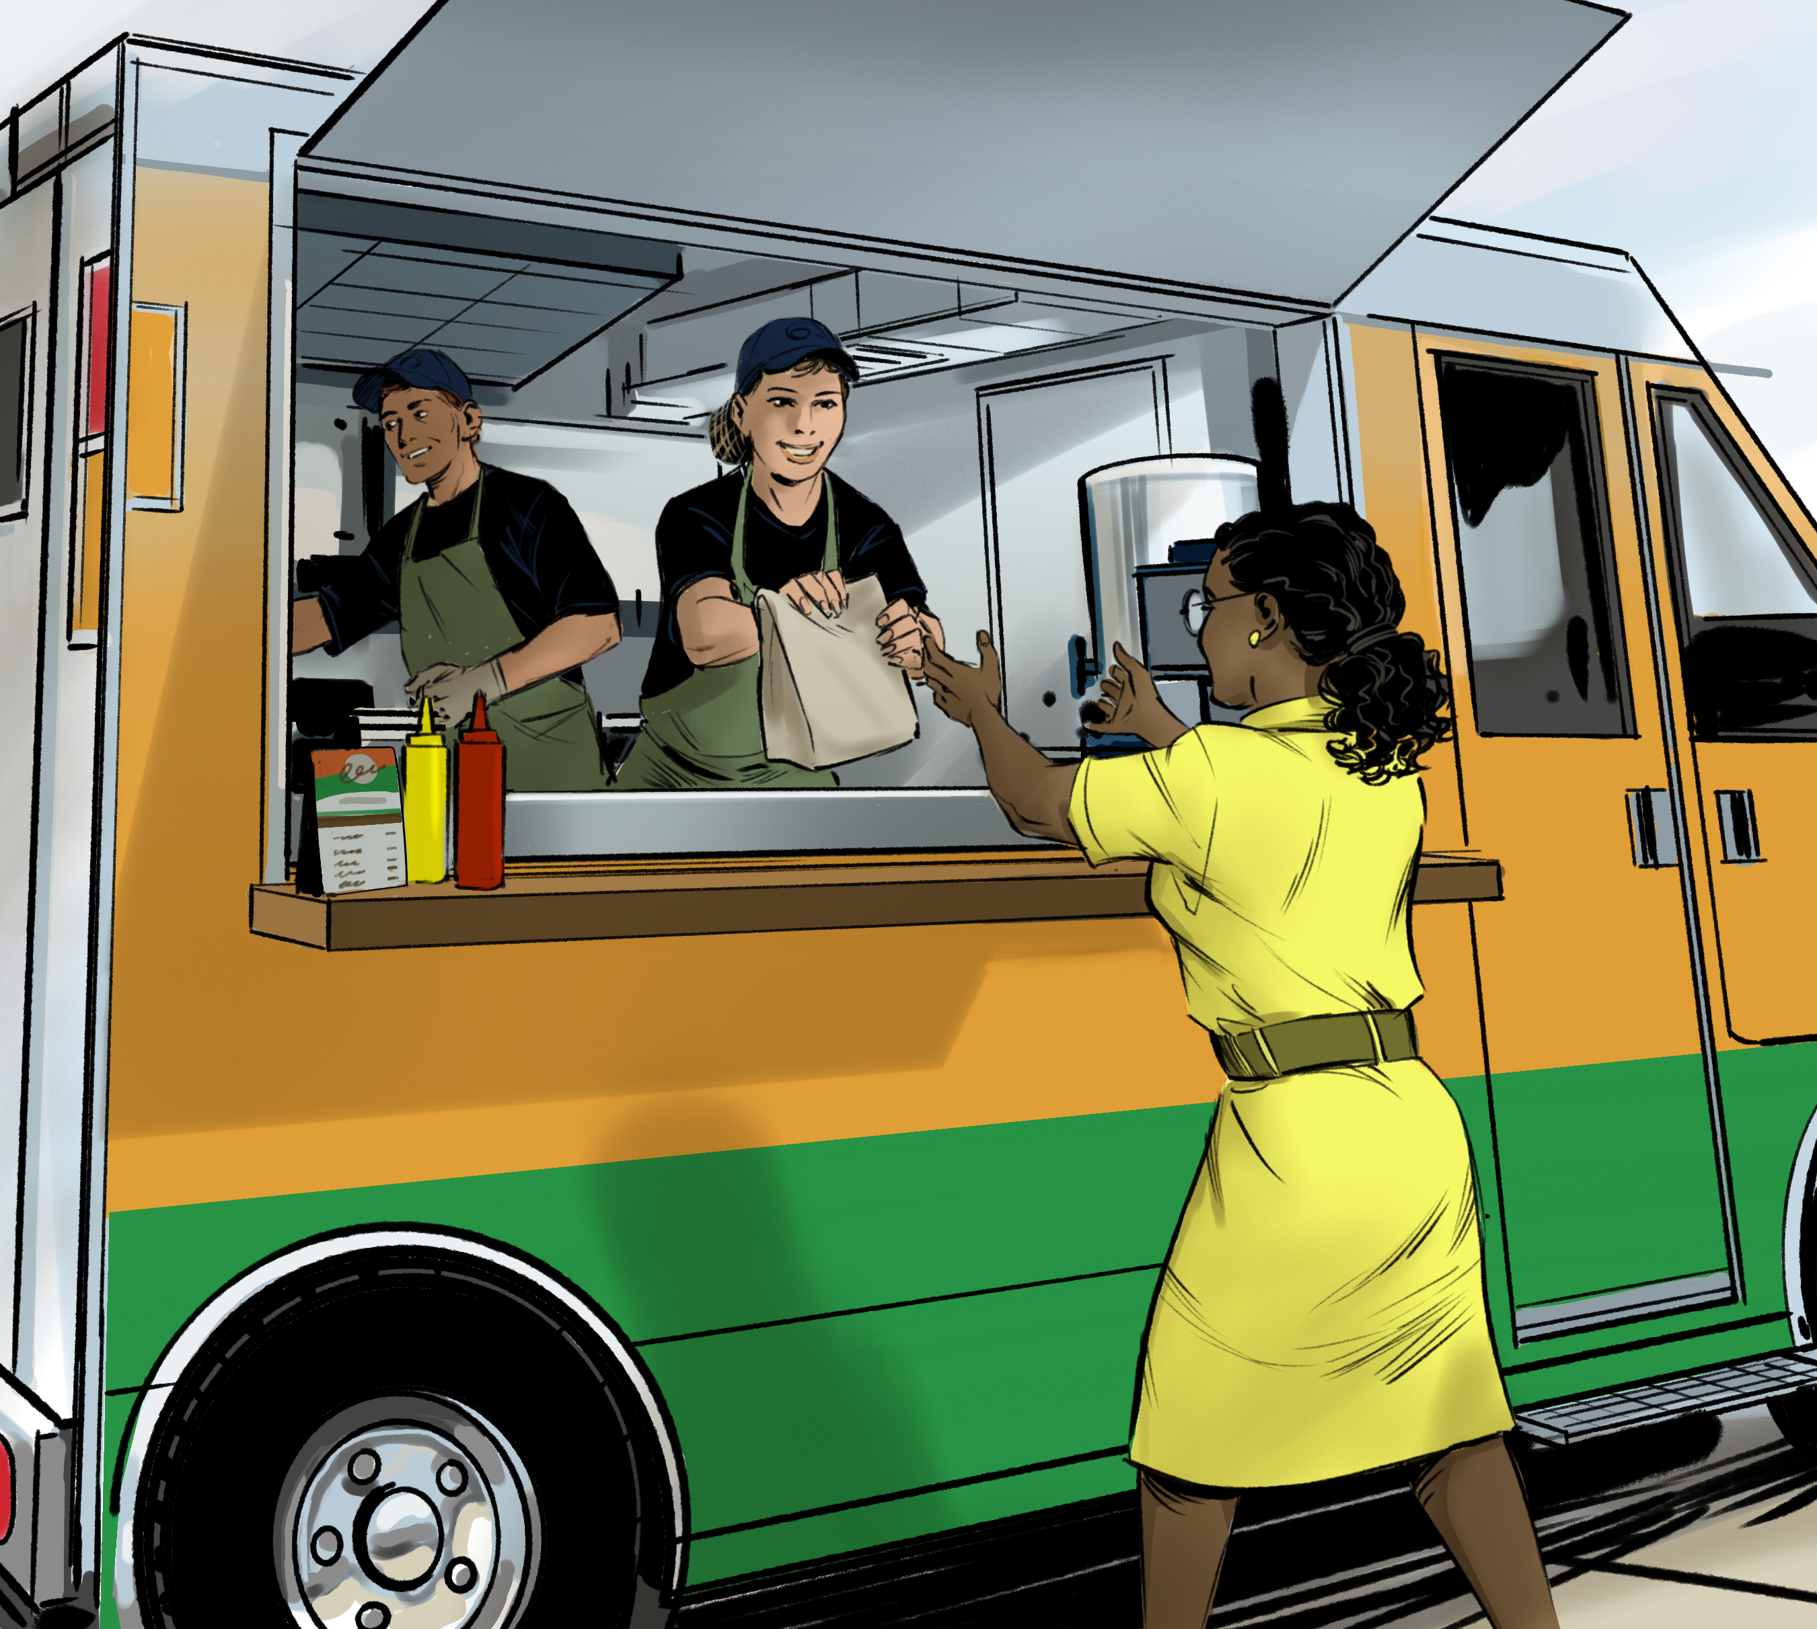
5
The Flow of Food: An Introduction

Slide 2
Learning Objectives
After completing this chapter, students should be able to:
Identify types of contaminants and methods of prevention.
Explain ways to prevent time-temperature abuse.
Describe how to use and maintain thermometers.
Describe how to calibrate a thermometer.

Slide 3
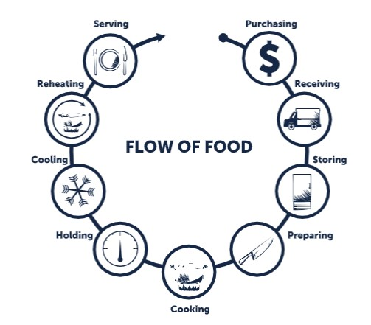
5.1 Hazards in The Flow of Food
The Flow of Food:
The path food takes through your operation.
How to keep food safe throughout this path:
  Prevent cross-contamination
  Prevent time-temperature abuse
Notes:
Instructor Notes
*This slide contains Core Food Safety content.

Slide 4
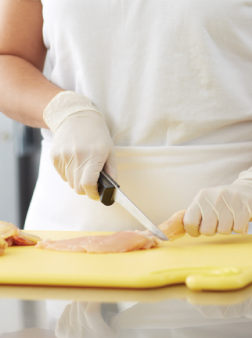
Cross-Contamination
Cross-contamination can occur almost anywhere within the Flow of Food. Steps to reduce the risk include:
Use separate equipment for raw and ready-to-eat food.
Clean and sanitize before and after tasks.
Prep raw and ready-to-eat food at different times.
Notes:
Instructor Notes
*This slide contains Core Food Safety content.

Slide 5
Time-Temperature Control
Food is being time-temperature abused whenever it is:
Held in the range of 41˚F and 135˚F (5˚C and 57˚C)
Cooked to the wrong internal temperature
Cooled or reheated incorrectly
Steps to prevent time-temperature abuse include:
Monitoring and recording temperatures
Using the correct tools
Understanding corrective actions
Notes:
Instructor Notes
*This slide contains Core Food Safety content.
Activity: How The Food Flows

Slide 6
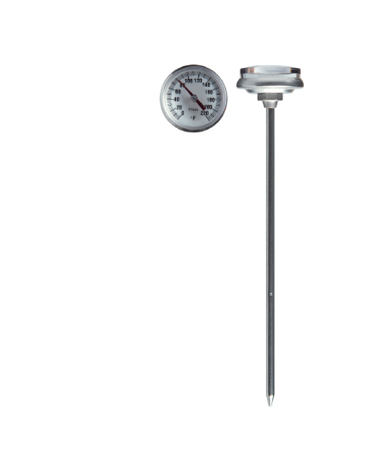
5.2 Monitoring Time and Temperature
A bimetallic stemmed thermometer checks temperatures from 0°F to 220°F (–18°C to 104°C). They should have the following features:
Calibration nut
Easy-to-read markings
Dimple
Notes:
Instructor Notes
*This slide contains Core Food Safety content.

Slide 7
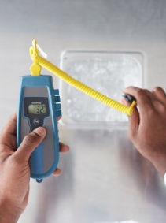
Monitoring Time and Temperature
Thermocouples and Thermistors
Measure temperatures through a metal probe.
May come with different types of probes
Infrared Thermometers
Measure the temperature of food and equipment surfaces.
Notes:
Instructor Notes
*This slide contains Core Food Safety content.

Slide 8
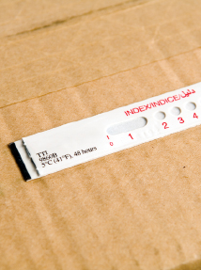
Other Temperature-Recording Devices
Maximum Registering Thermometer
Indicates the highest temperature reached during use
Time-temperature Indicator
Monitors both time and temperature
Notes:
Instructor Notes
*This slide contains Core Food Safety content.

Slide 9
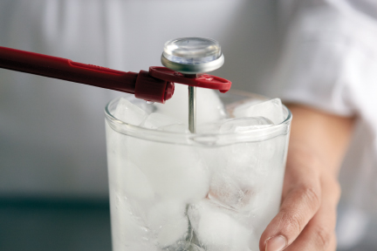
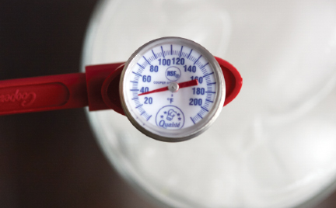
How to Calibrate Thermometers
Thermometers need regular calibration, or an adjustment, to give a correct reading.
There are two ways to calibrate a thermometer:
Boiling-point method
Ice-point method
Notes:
Instructor Notes
*This slide contains Core Food Safety content.

Slide 10
General Thermometer Guidelines
Thermometers must be washed, rinsed, sanitized, and air-dried.
Glass thermometers can only be used if enclosed in a shatterproof casing.
Thermometers need to be accurate to within ±2°F or ±1°C.
  Calibrate thermometers at these times.
  After they have been bumped or dropped
  After they have been exposed to extreme temperature changes
  Before deliveries arrive
  Before each shift
Notes:
Instructor Notes
*This slide contains Core Food Safety content.

Slide 11
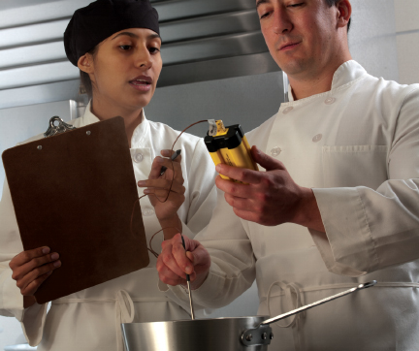
General Thermometer Guidelines
When checking the temperature of food:
  Insert the thermometer stem or probe into thickest part of the food.
  Take more than one reading in different spots.
  Wait for the reading to steady.
Notes:
Instructor Notes
*This slide contains Core Food Safety content.

Slide 12
What are some ways food can be time-temperature abused?
What are some ways to help food handlers keep regular temperature logs?
How is a thermometer calibrated using the ice-point method?
Notes:
Answers
1. What are some ways food can be time-temperature abused?
Food is being time-temperature abused whenever it is handled in the following ways:
It is cooked to the wrong minimum internal temperature.
It is held at the wrong temperature.
It is cooled or reheated incorrectly.
2. What are some ways to help food handlers keep regular temperature logs?
Have food handlers record temperatures regularly. Make sure they write down when the temperatures were taken. Print sample forms for recording this information. Post them on clipboards outside of coolers and freezers, near prep areas, and next to cooking and holding equipment.
3. How is a thermometer calibrated using the ice-point method?
* These are the steps for calibrating a thermometer using the ice-point method:
1. Fill a large container with ice. Use crushed ice if you have it. Add tap water until the container is full. Stir the mixture well.
2. Put the thermometer stem or probe into the ice water. Make sure the sensing area is completely submerged. Wait 30 seconds or until the indicator stops moving. Do not let the stem or probe touch the sides or bottom of the container.
3. Adjust the thermometer so it reads 32°F (0°C). To calibrate a bimetallic stemmed thermometer, adjust it by holding the calibration nut with a wrench or other tool. To calibrate a thermocouple or thermistor, follow the manufacturer’s directions.

